Slide 1
Doctor Online
Issac Ke Bill
2018/07/20

Slide 2
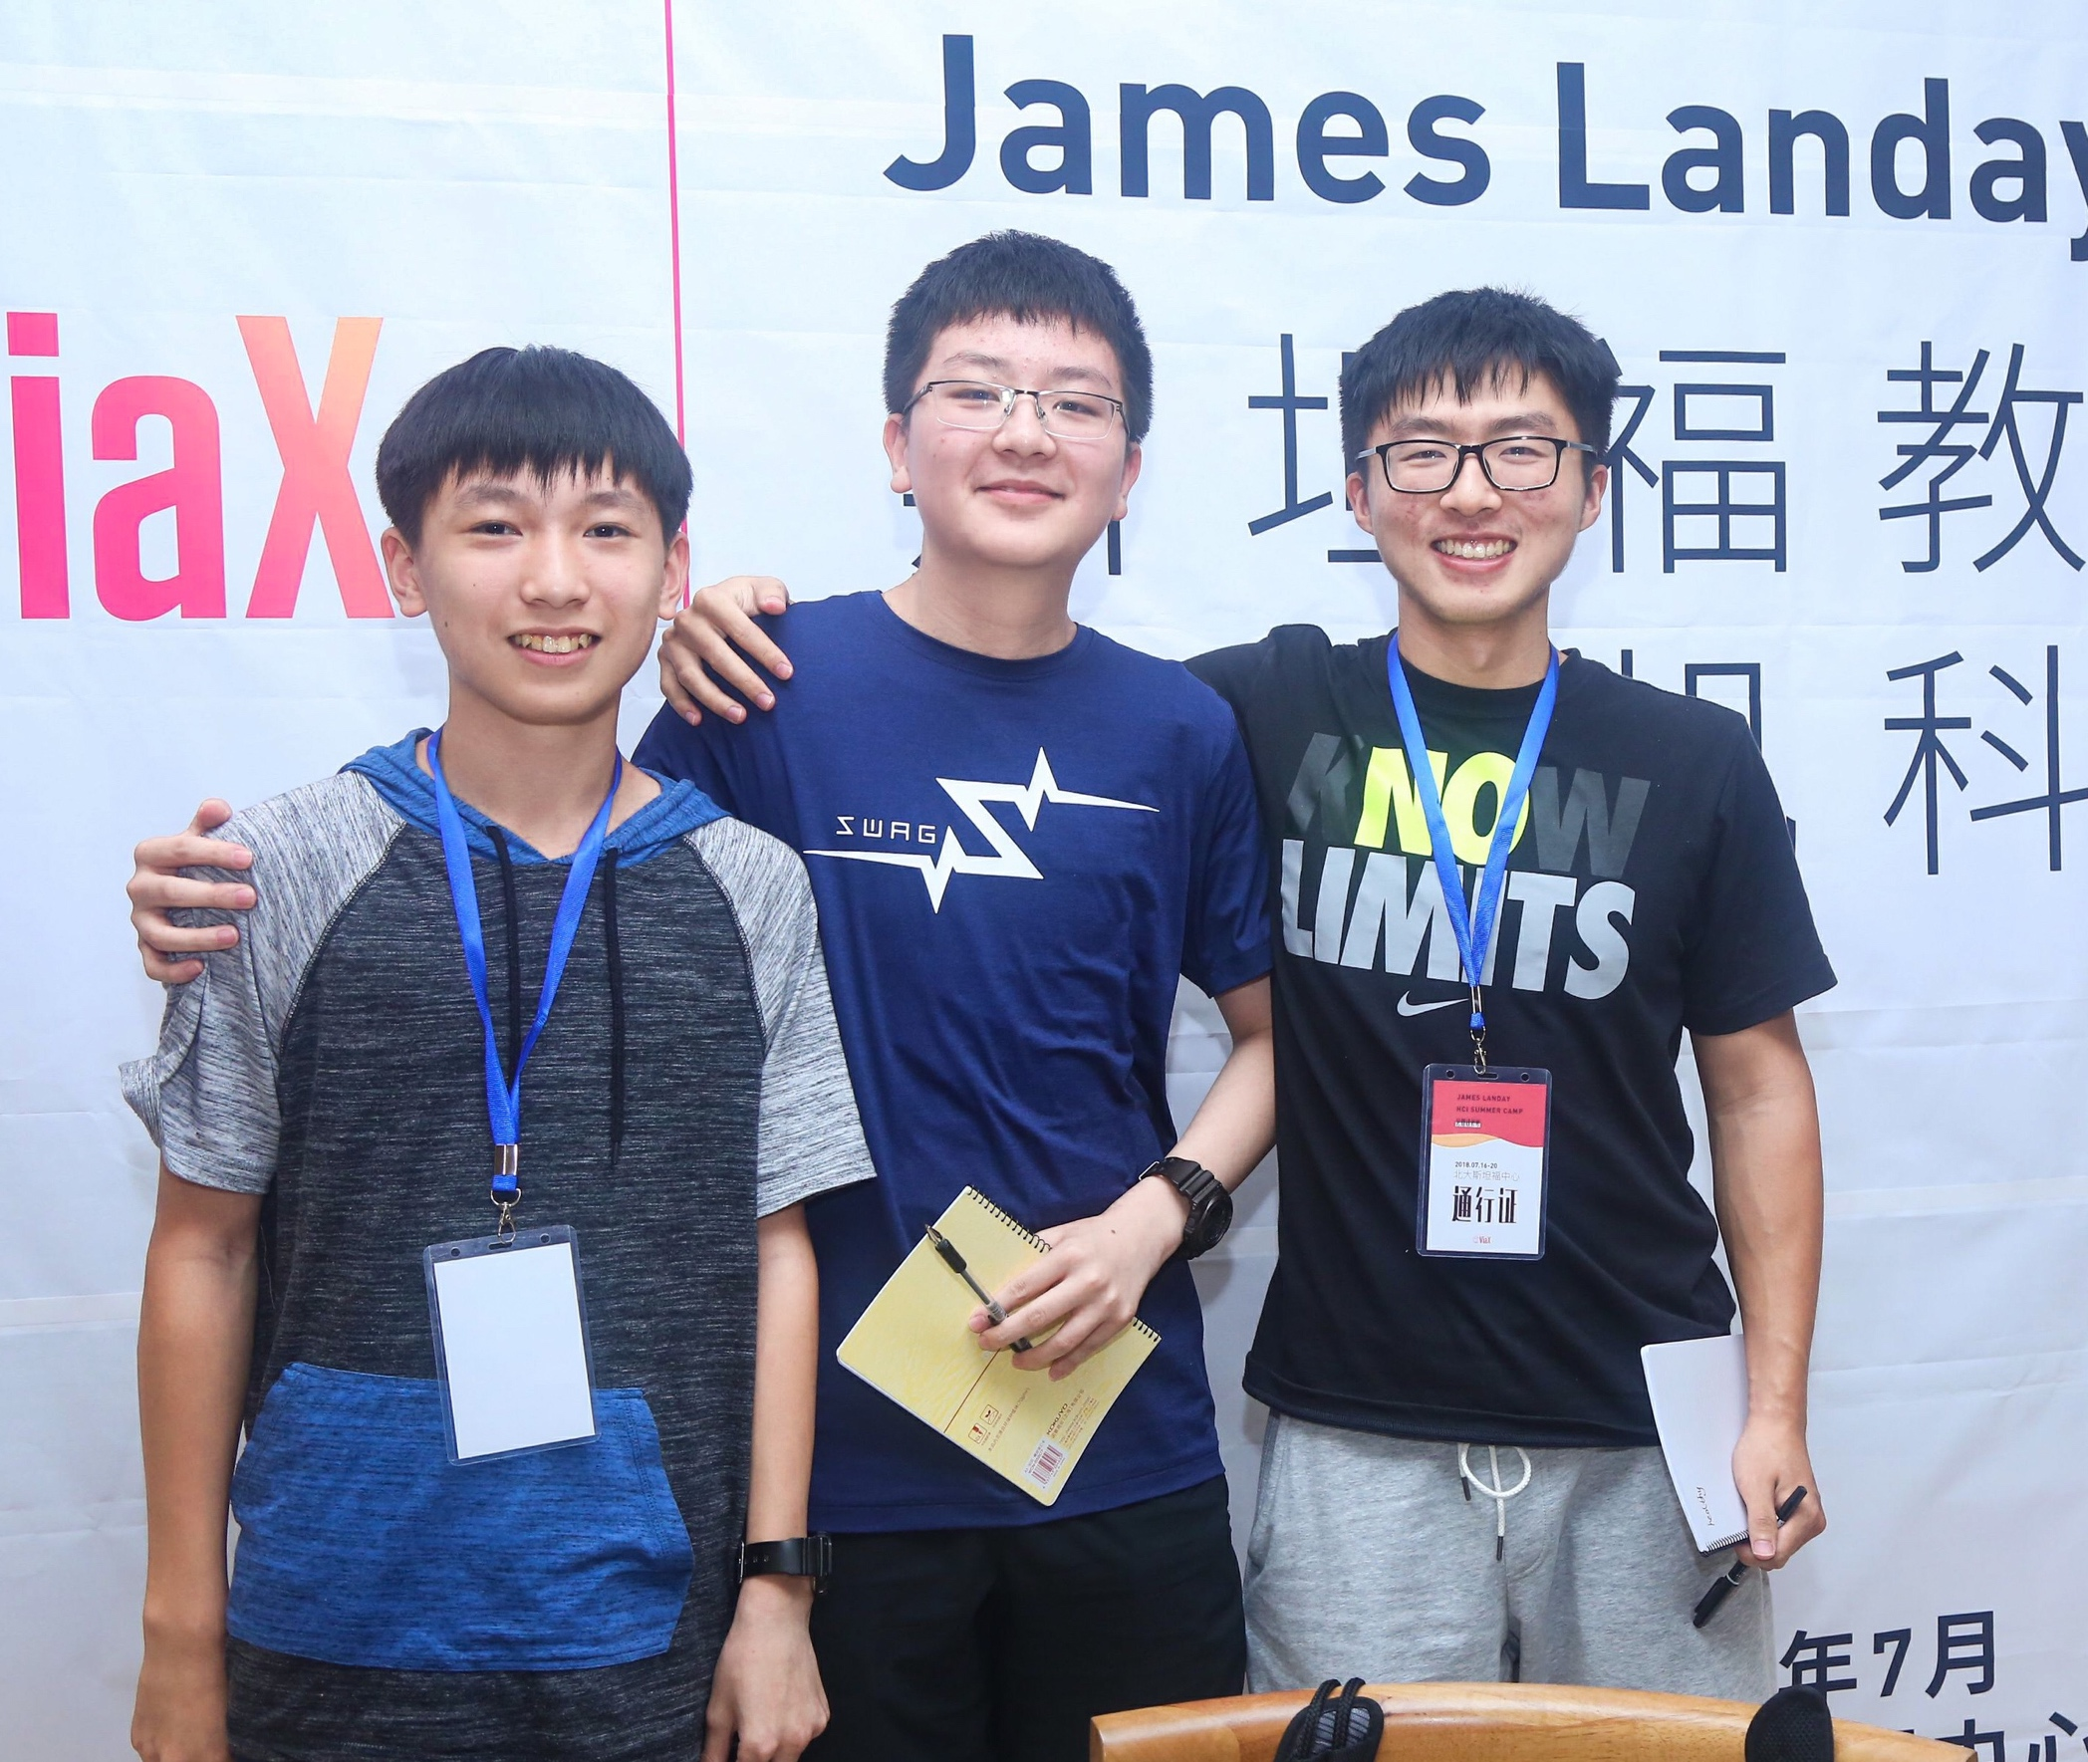
About the Team
Bill
Ke
Issac
Summer 2018
Designing & Prototyping Smart Applications – James Landay CS Summer Camp – viaX

Slide 3
Needfinding
Jul.16th ~ Jul.17th
Mon. & Tue.
Summer 2018
Designing & Prototyping Smart Applications – James Landay CS Summer Camp – viaX

Slide 4
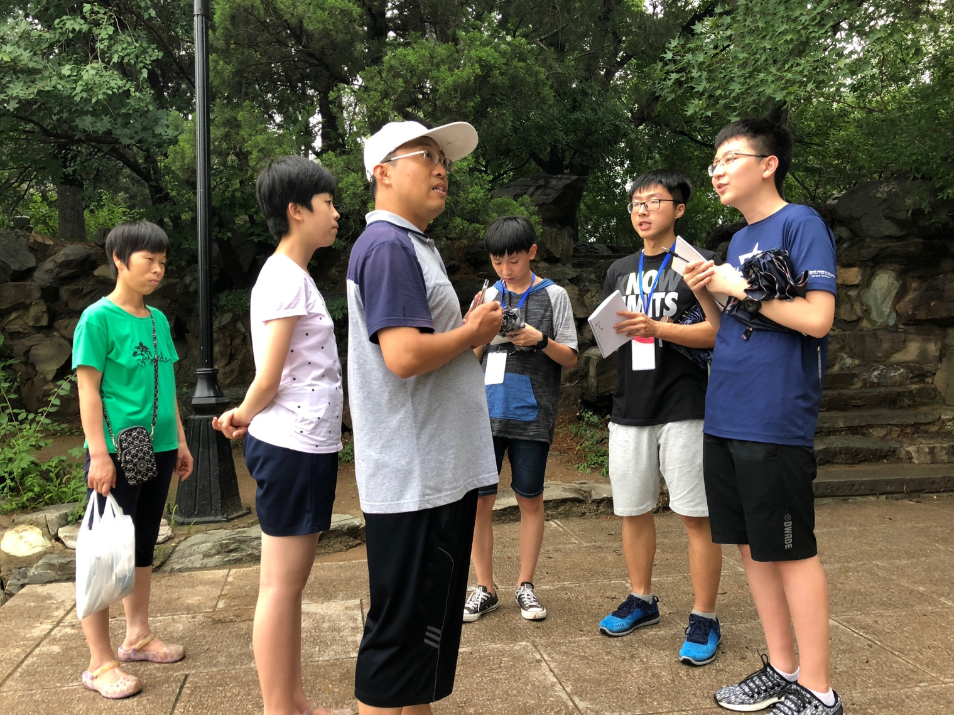
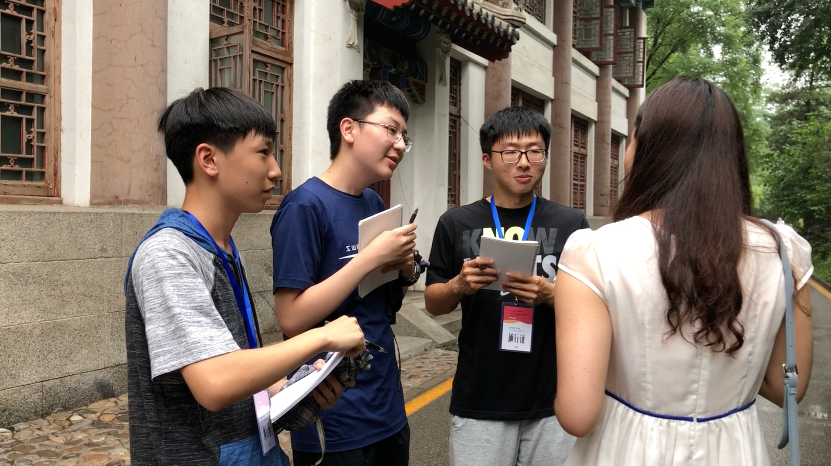
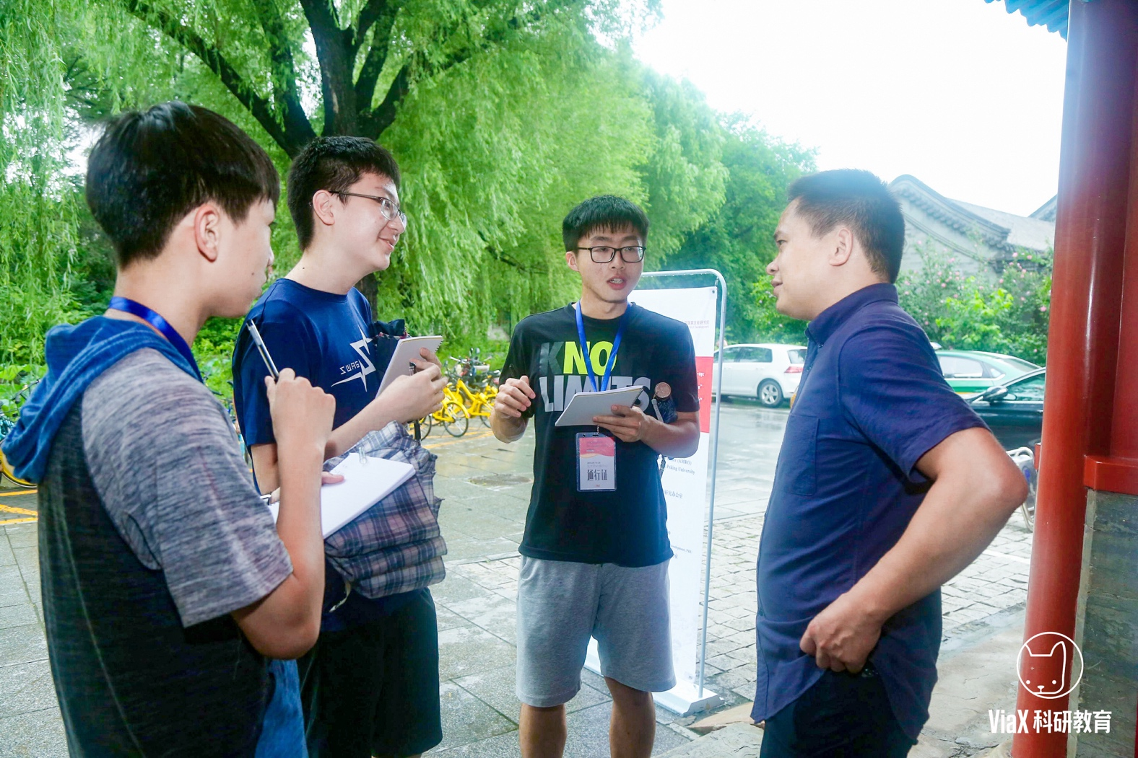
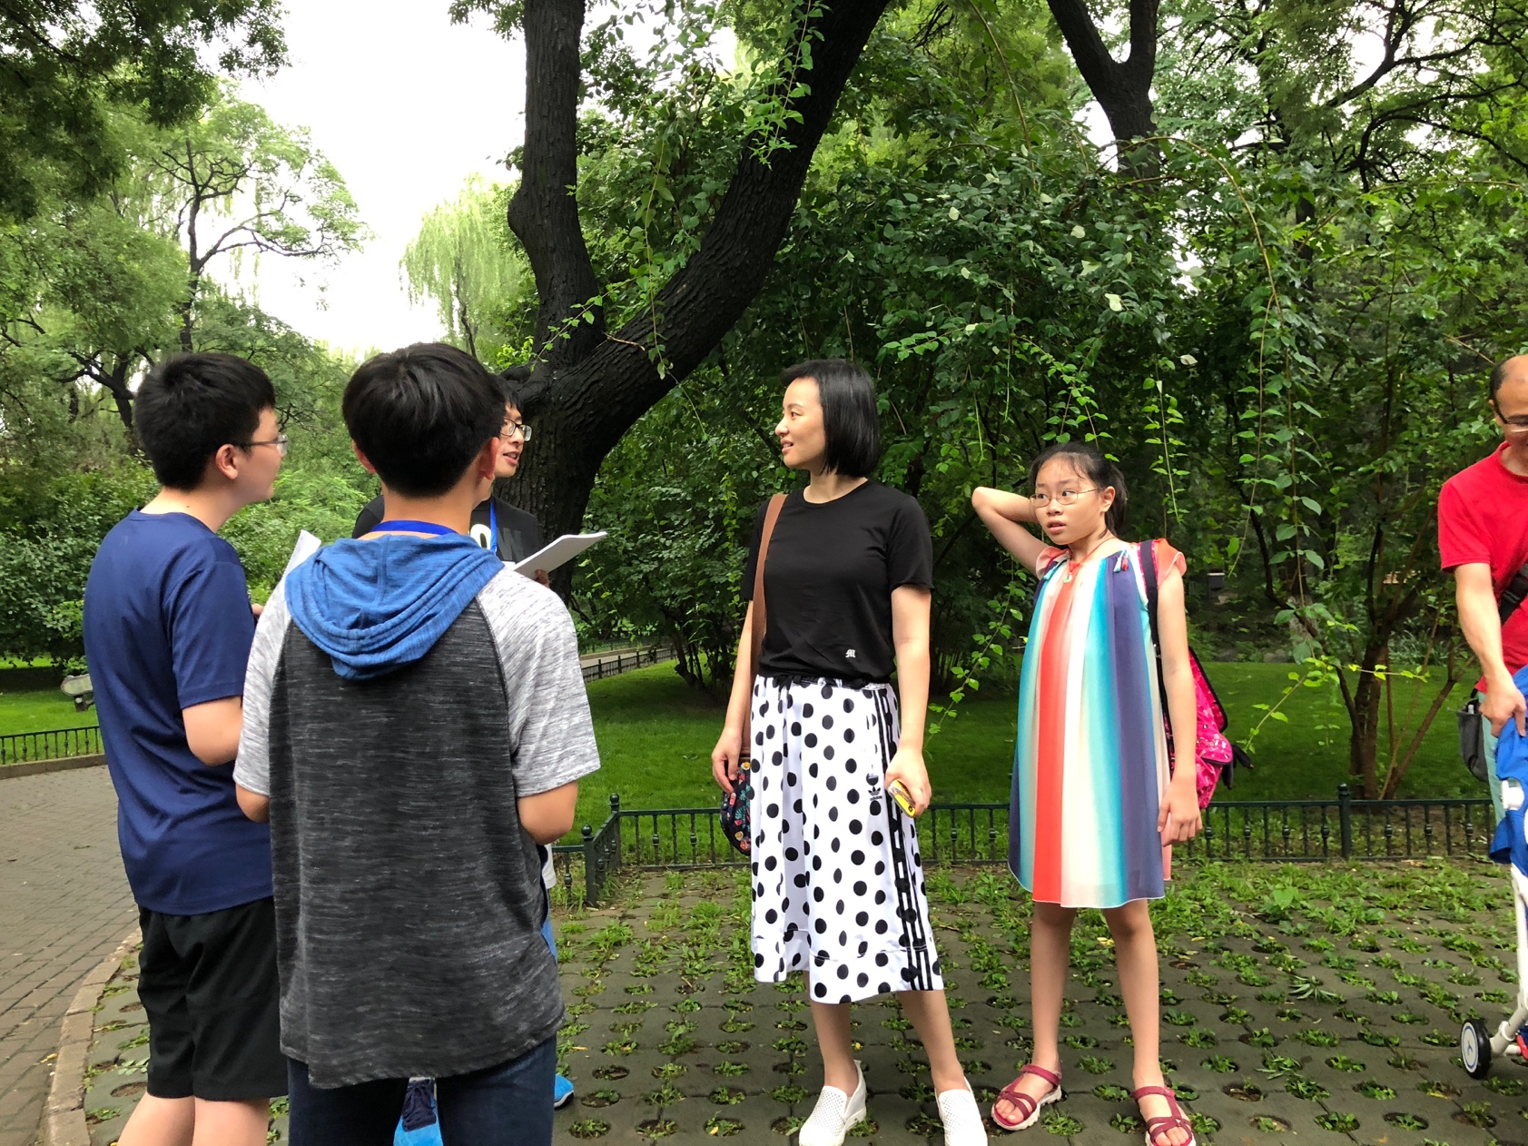
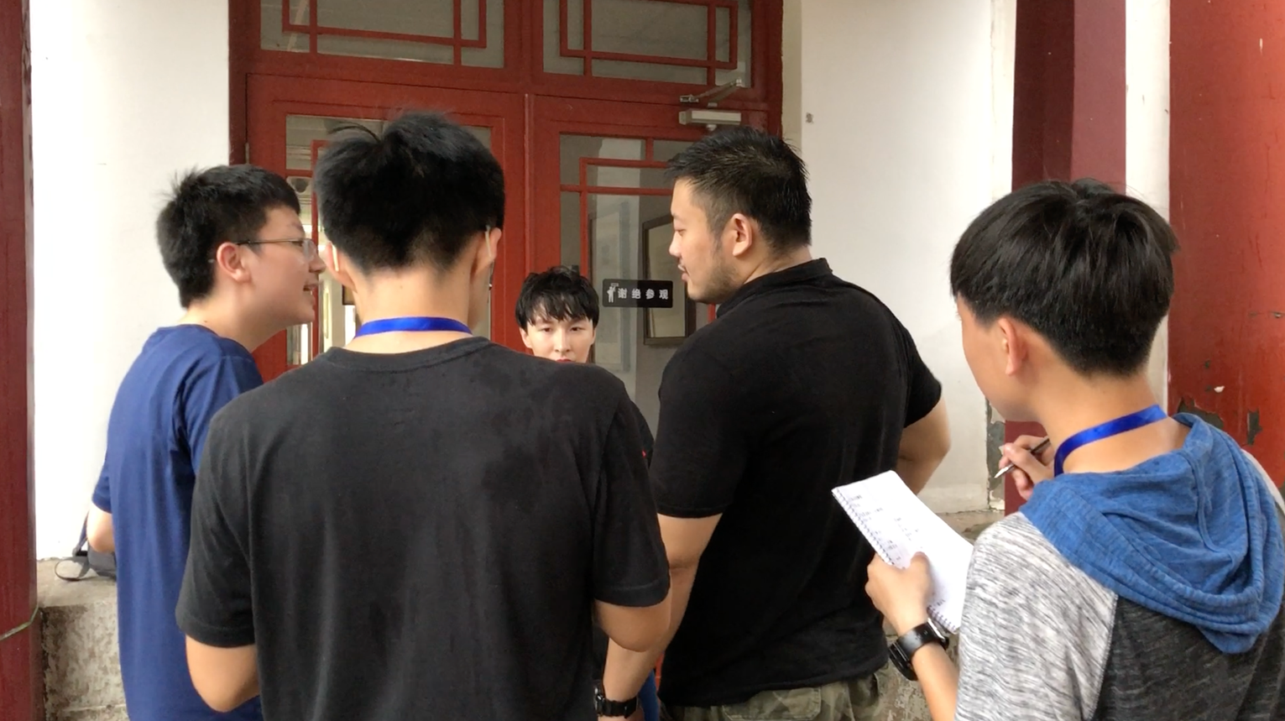
Needfinding
“There’s hardly anyone to help you before completing the registration”
Summer 2018
Designing & Prototyping Smart Applications – James Landay CS Summer Camp – viaX

Slide 5
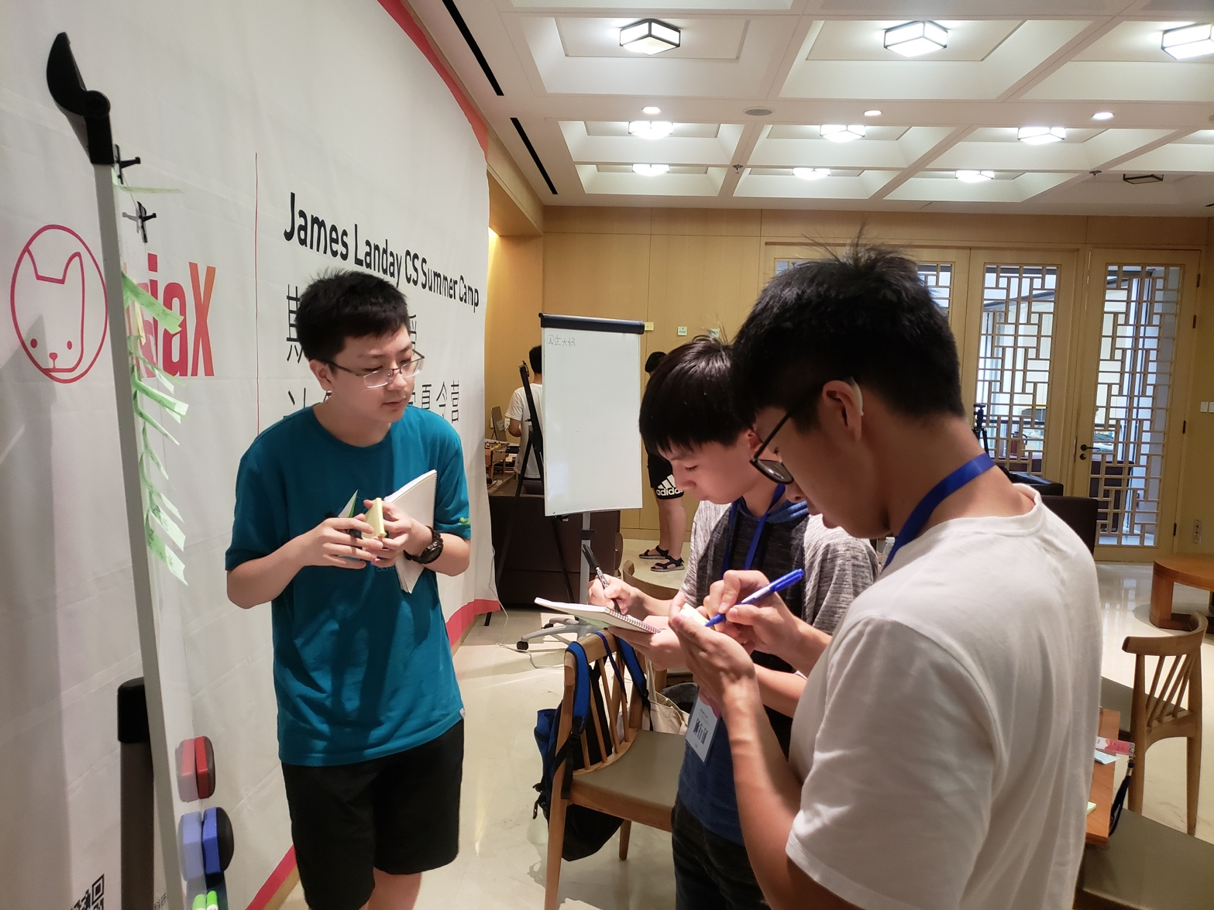
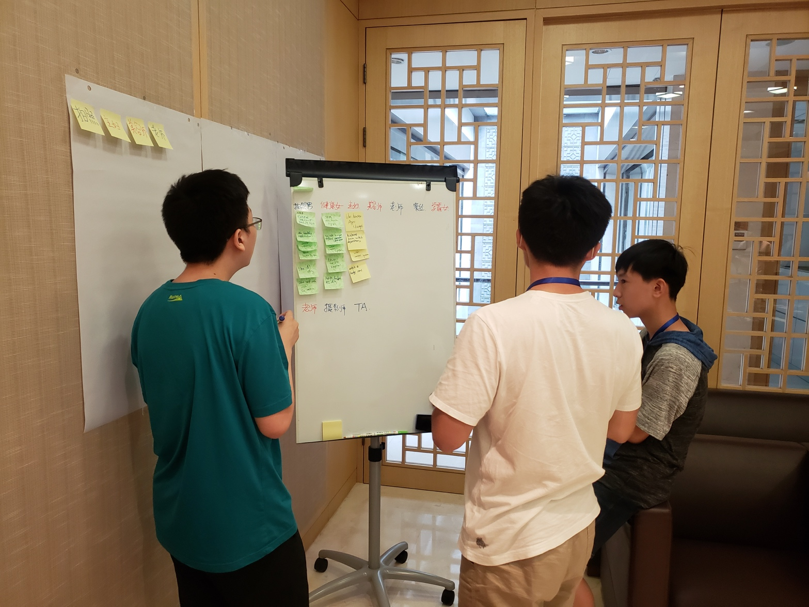
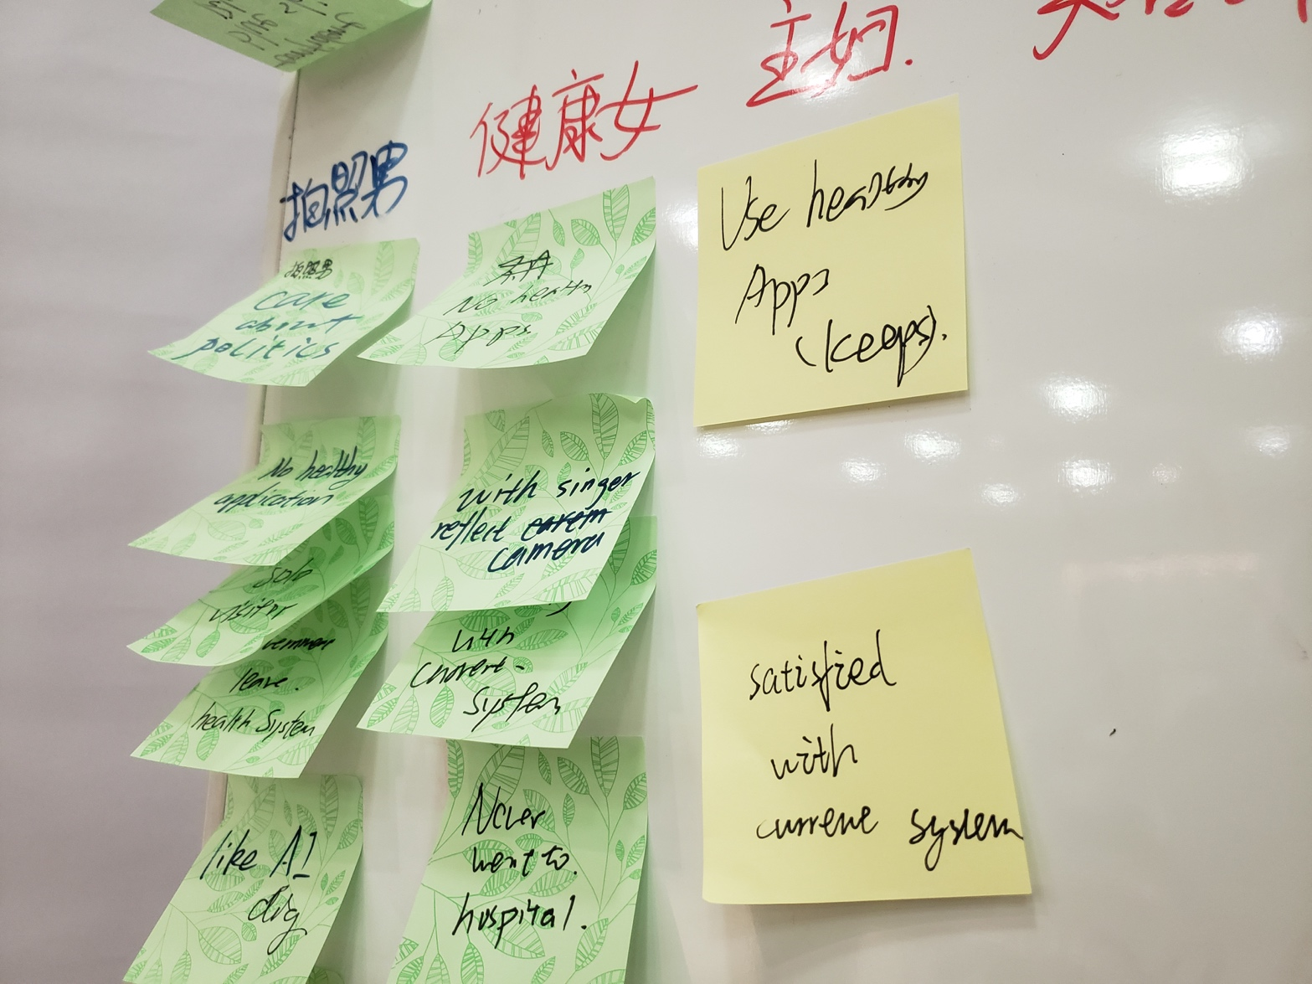
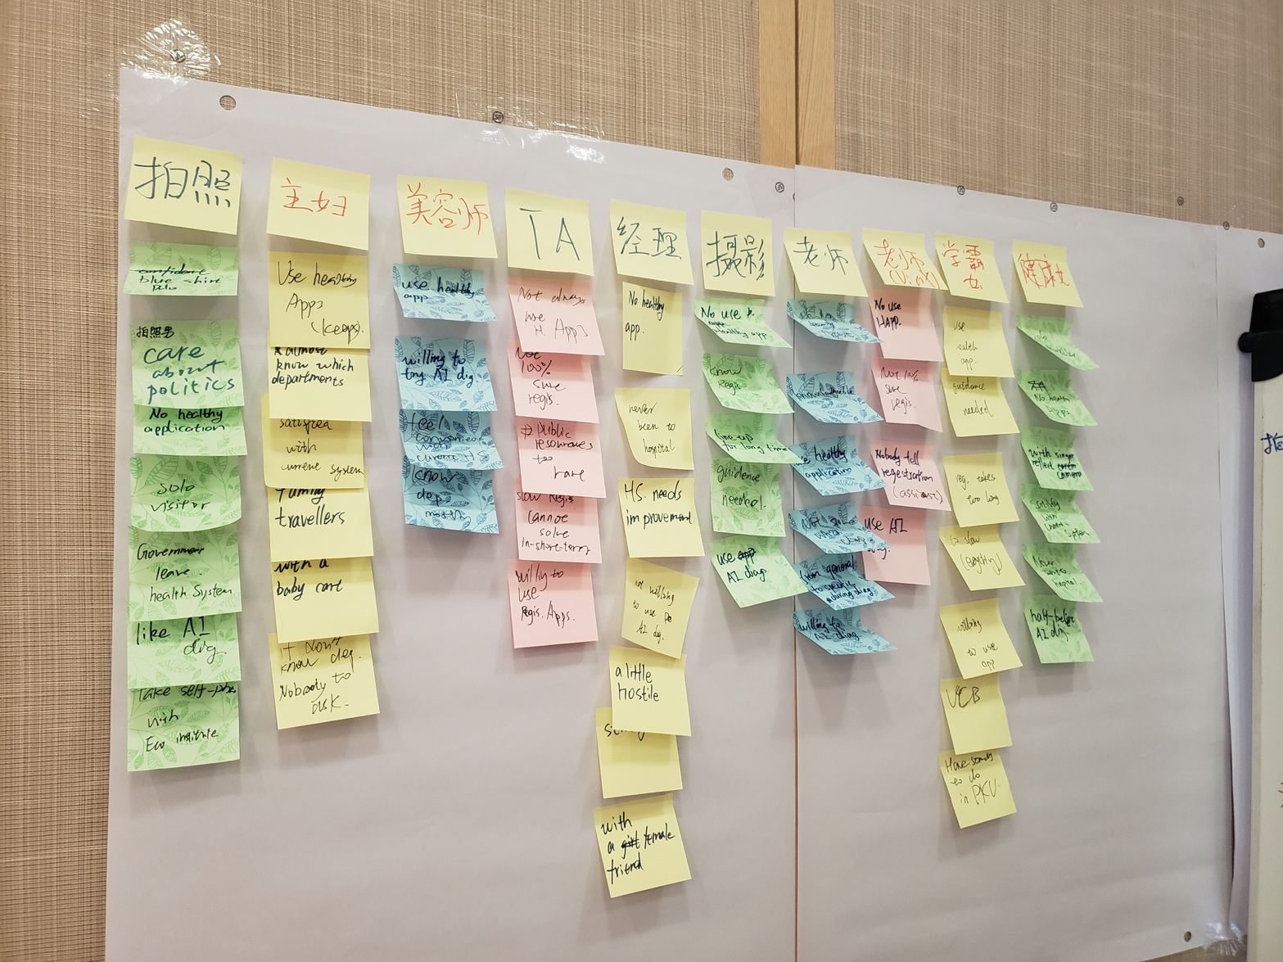
Needfinding
Collate
Compare
Integrate
Sort
Summer 2018
Designing & Prototyping Smart Applications – James Landay CS Summer Camp – viaX

Slide 6
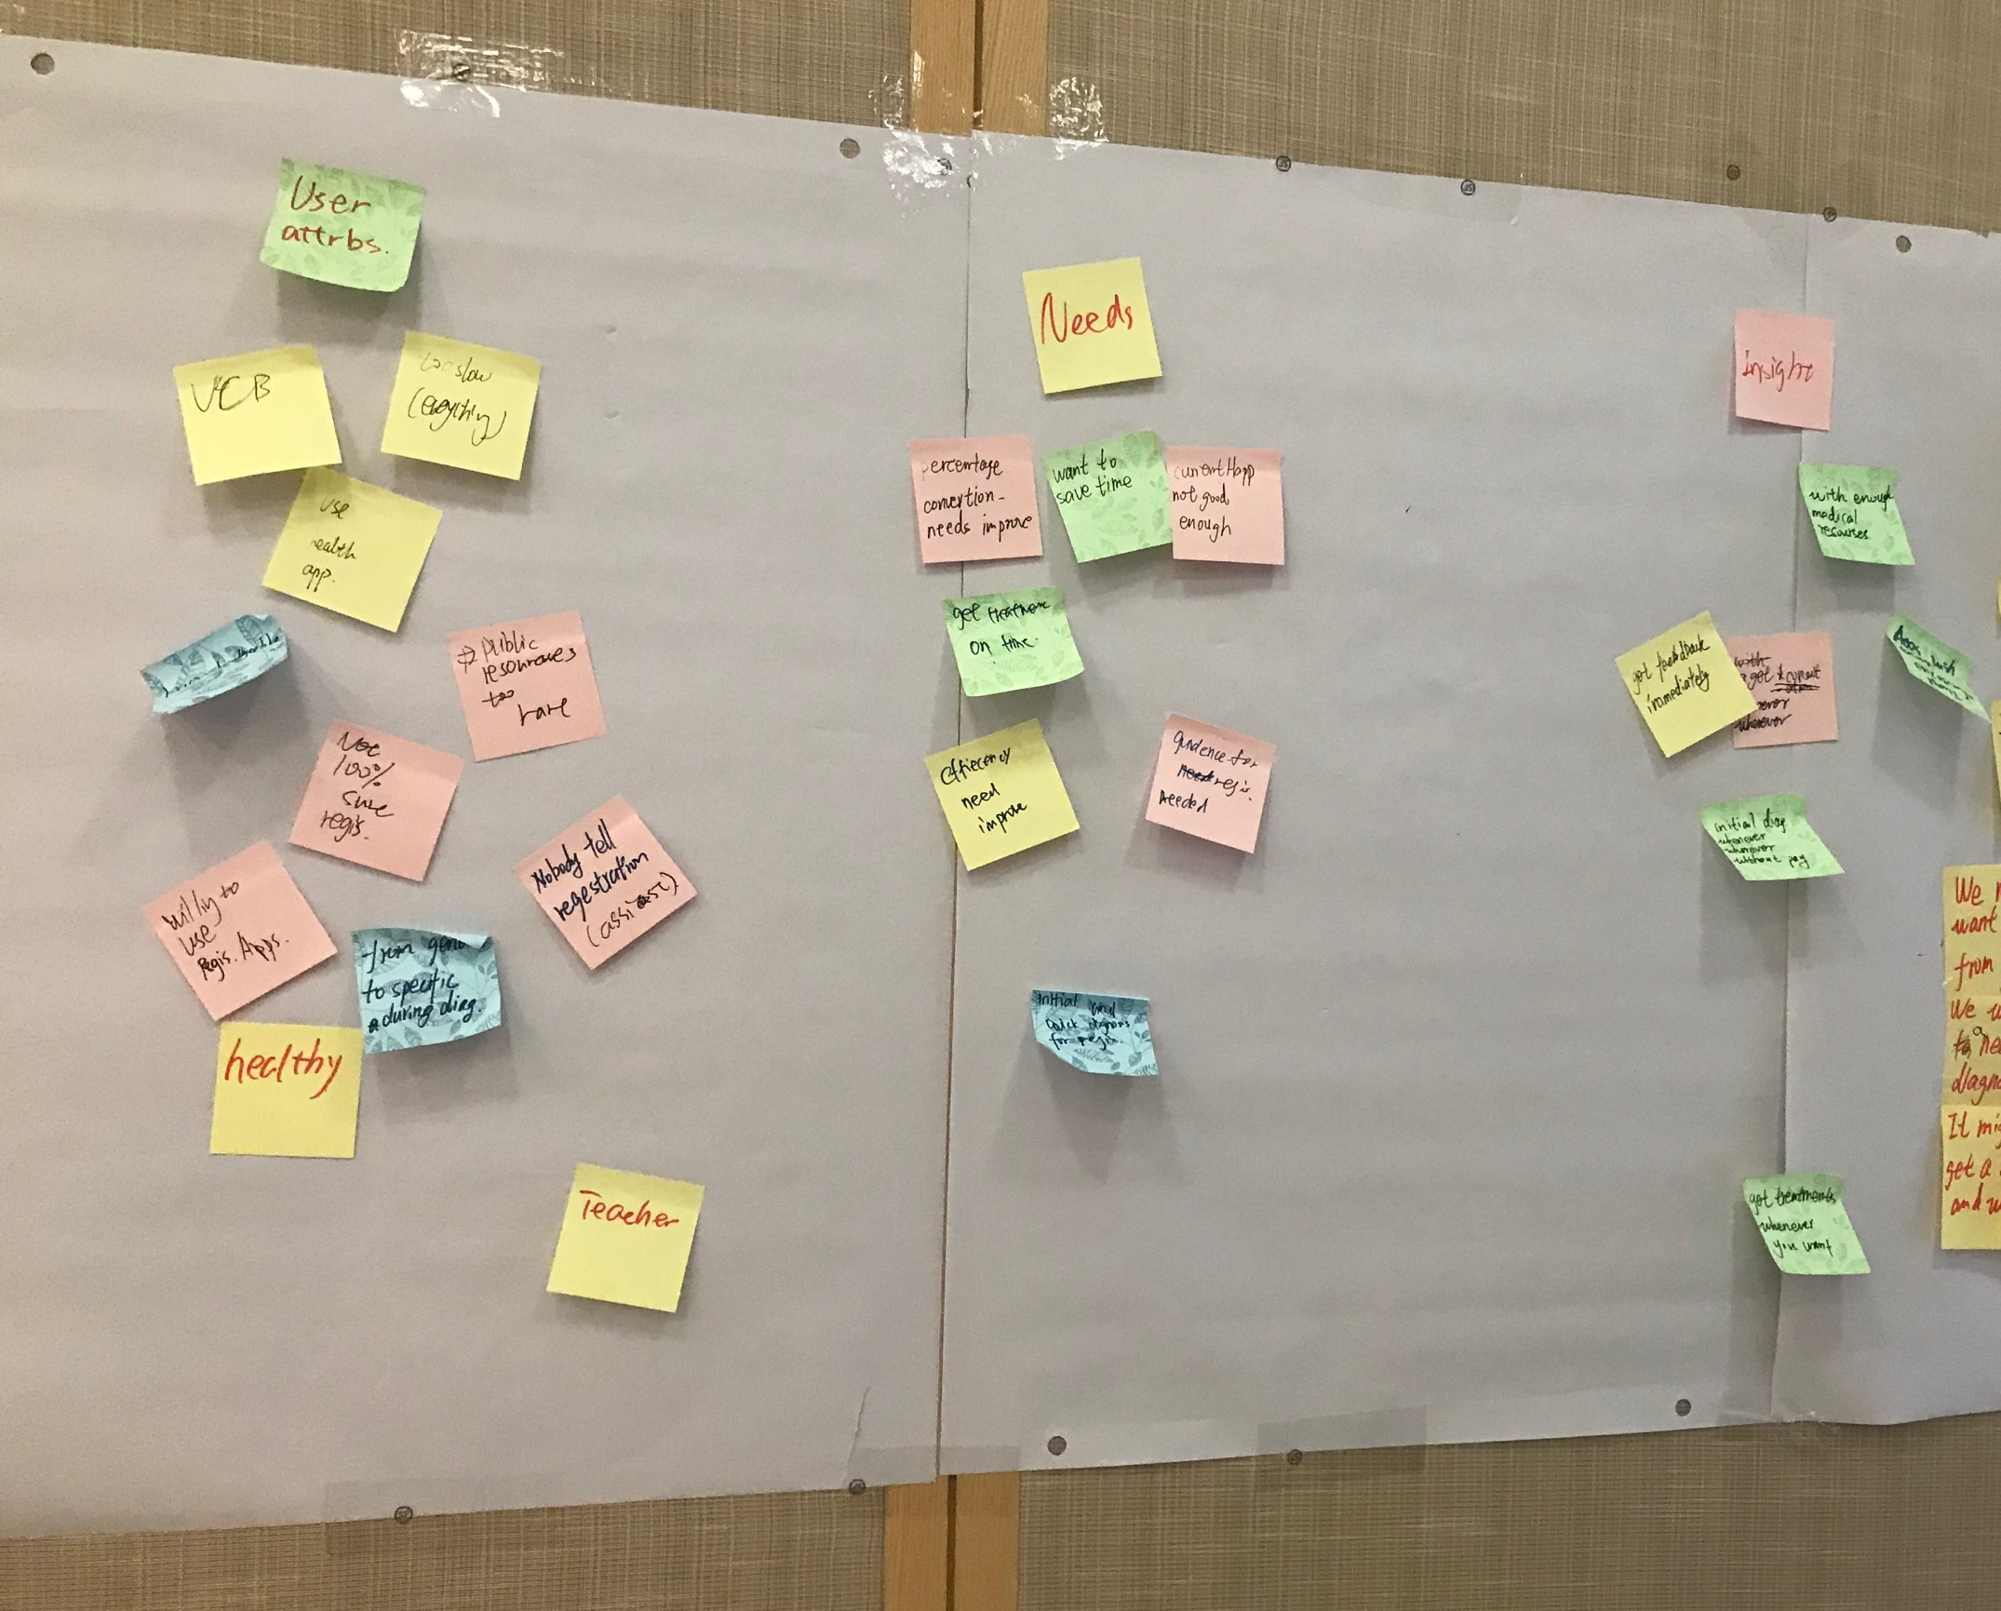
Needfinding
Insights:
Get feedback immediately
Get consultation whenever/wherever is needed
Initial diagnosis whenever/wherever is needed
Get treatment whenever/wherever is needed
Summer 2018
Designing & Prototyping Smart Applications – James Landay CS Summer Camp – viaX

Slide 7
& Experience Prototyping
POV
Jul.17th ~ Jul. 18th
Tue. & Wed.
Summer 2018
Designing & Prototyping Smart Applications – James Landay CS Summer Camp – viaX - Stanford Center

Slide 8
Point Of View
We met Karen, a student from UCB. We were amazed to realize that there is actually a need for guidance in hospital registration. It might be game-changing if she could get a consultation or help with the registration process anywhere at anytime.
We met Peter, a teacher who wants the diagnosis to be from general to specific. We were surprised to realize a need an initial and quick diagnosis for registration. It might be game-changing to be able to get an initial diagnosis whenever and wherever he wants.
Summer 2018
Designing & Prototyping Smart Applications – James Landay CS Summer Camp – viaX

Slide 9
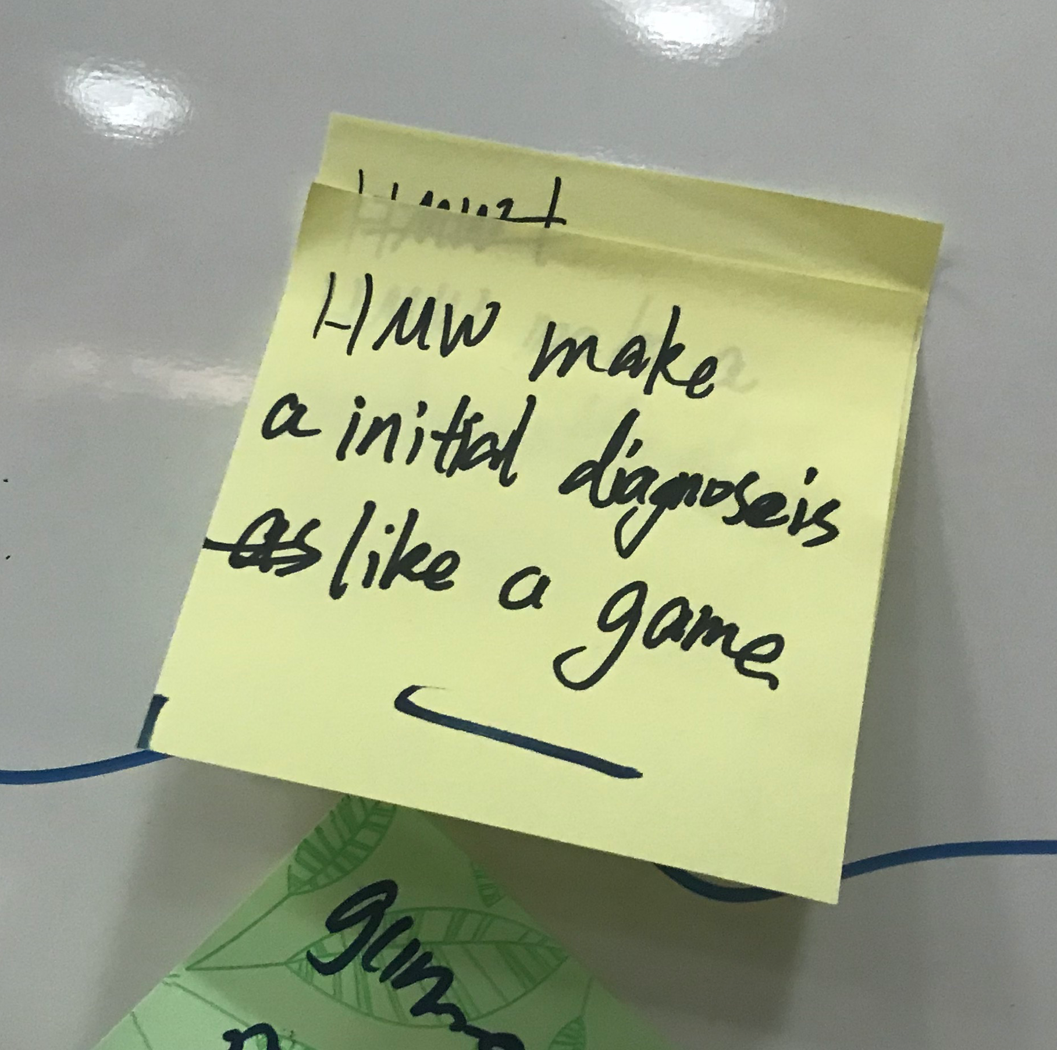
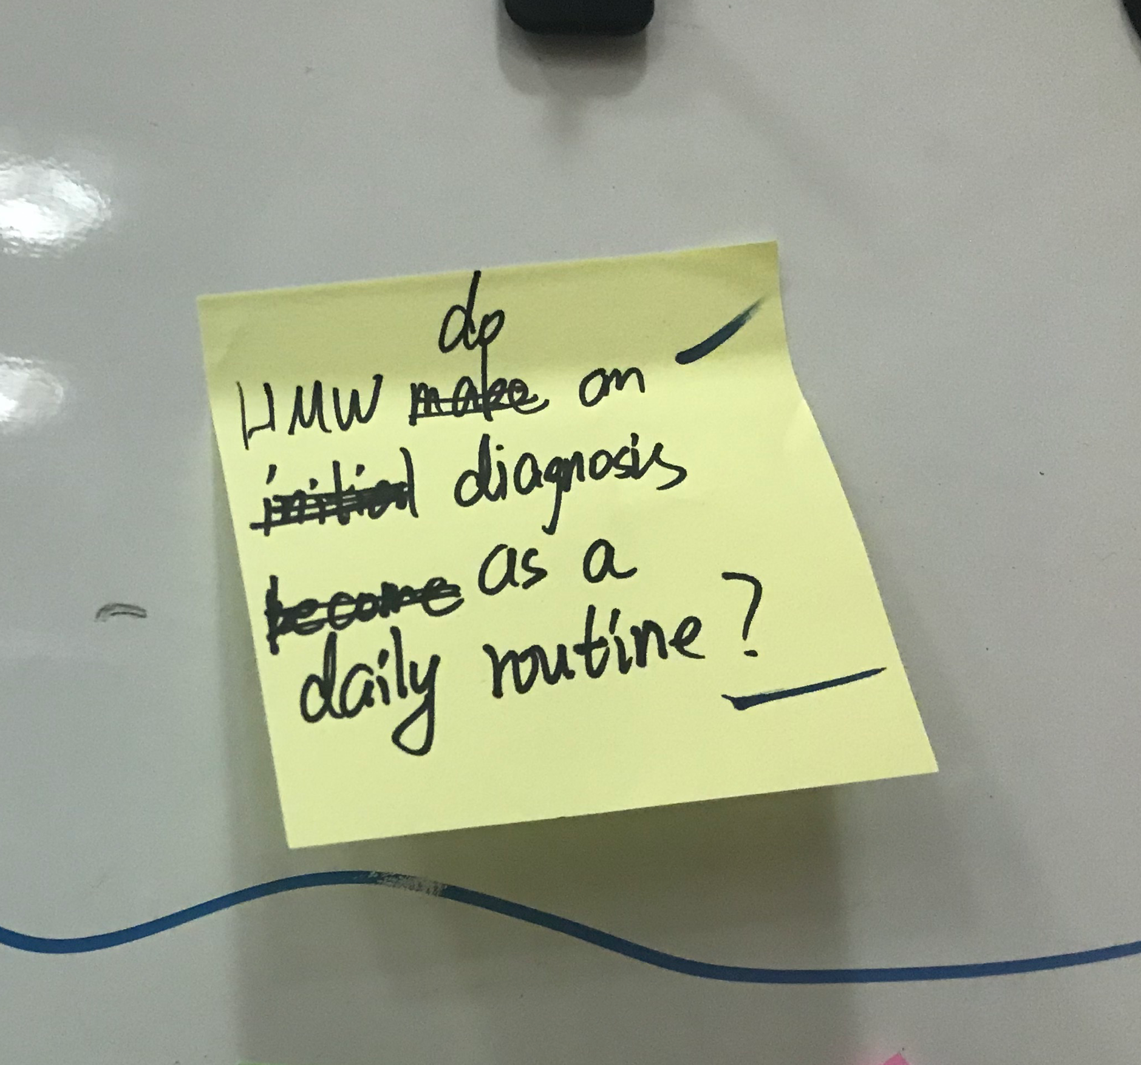
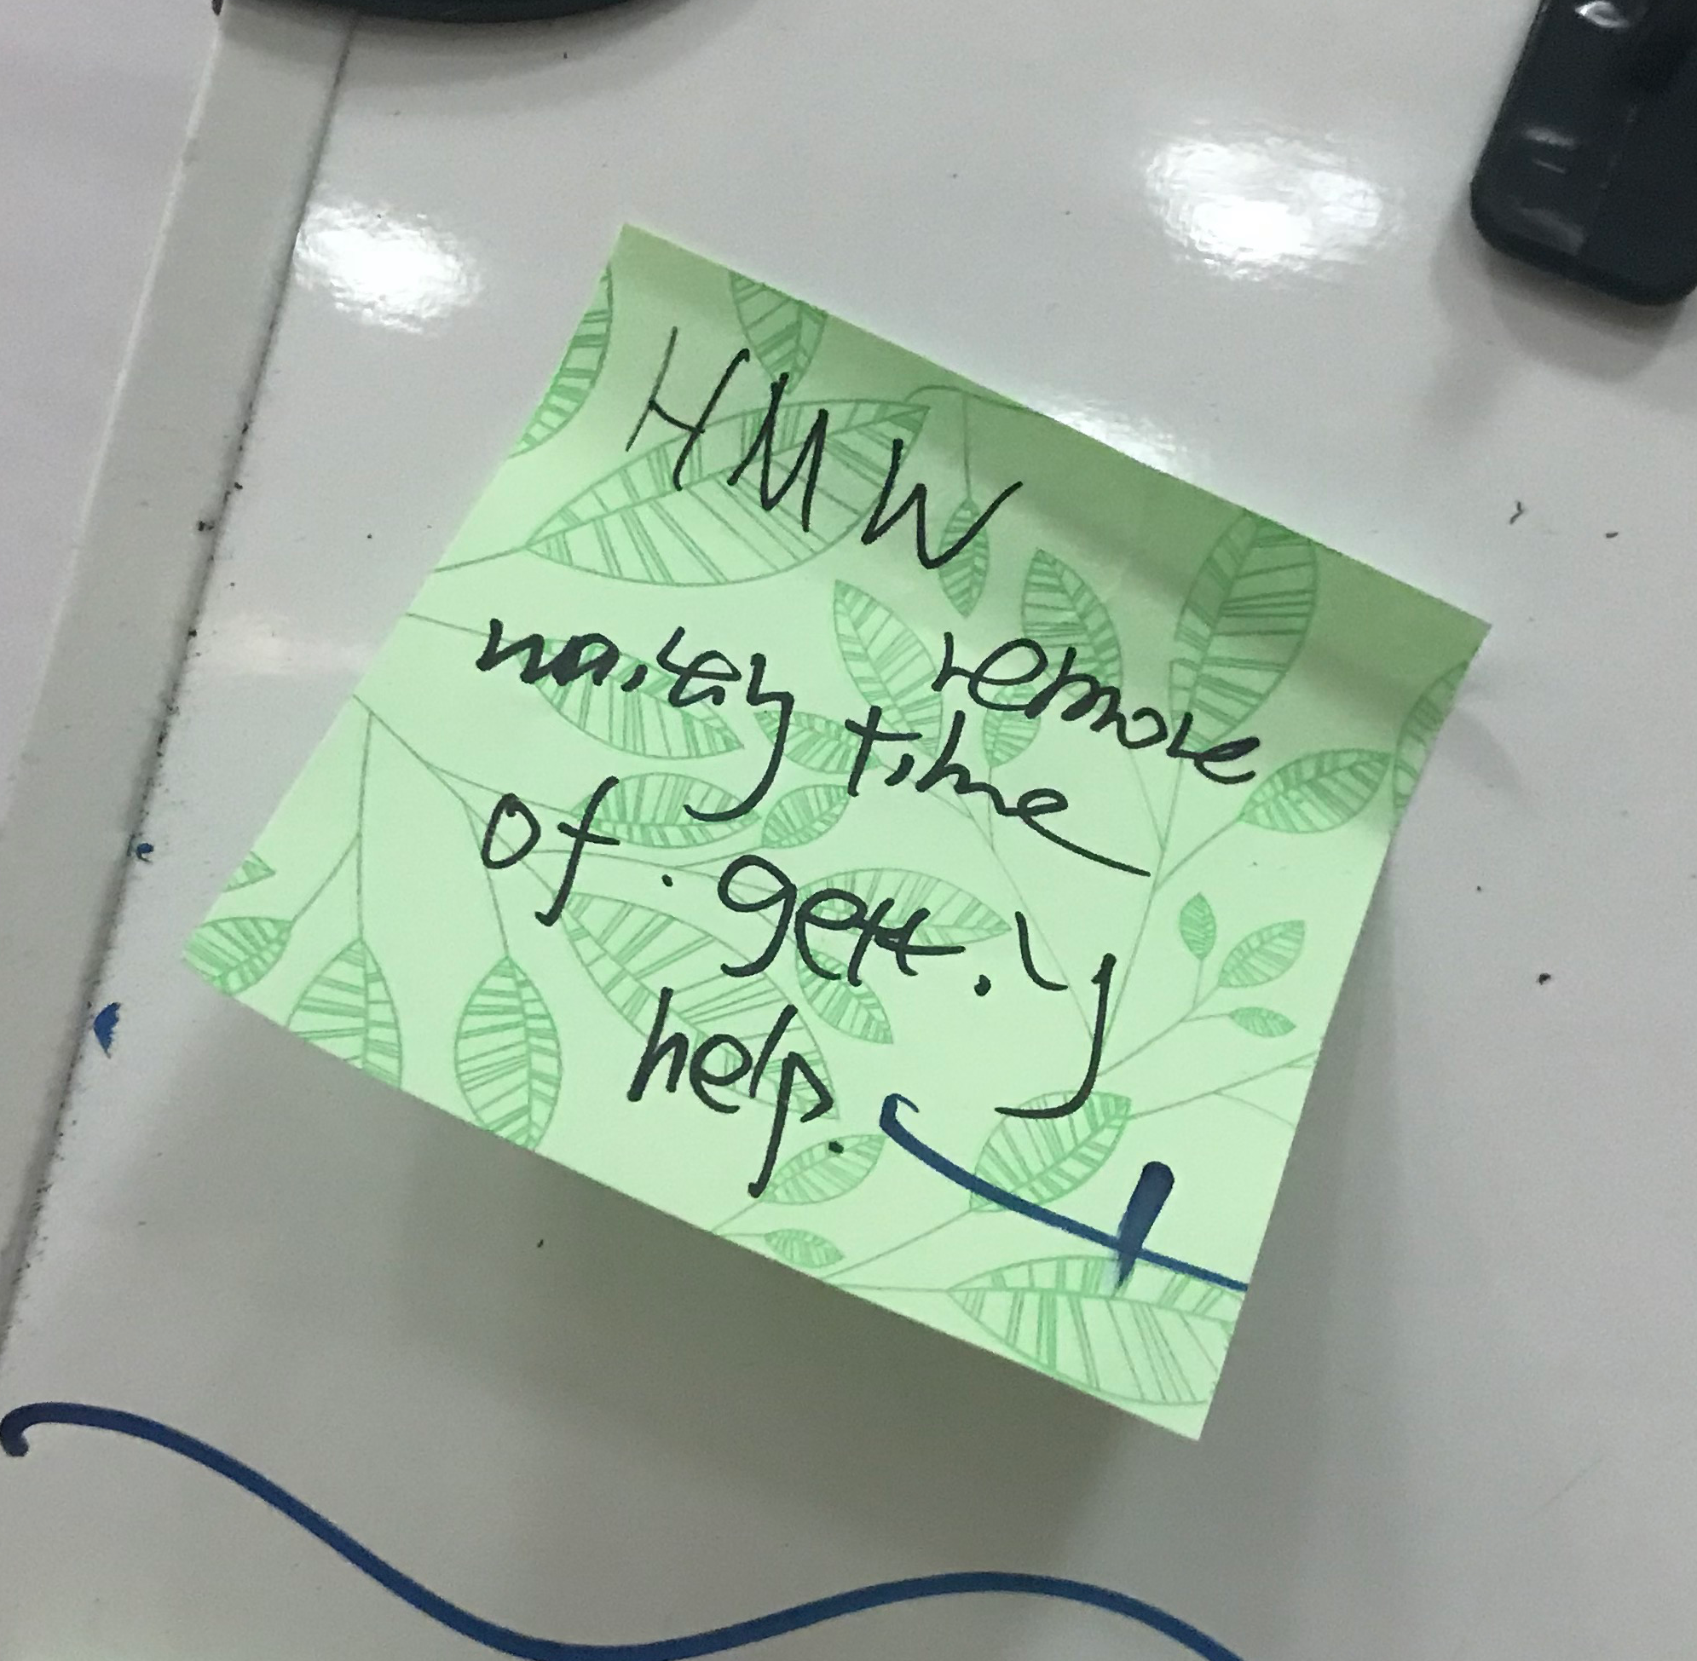
How Might We?
Chosen Questions
Summer 2018
Designing & Prototyping Smart Applications – James Landay CS Summer Camp – viaX

Slide 10
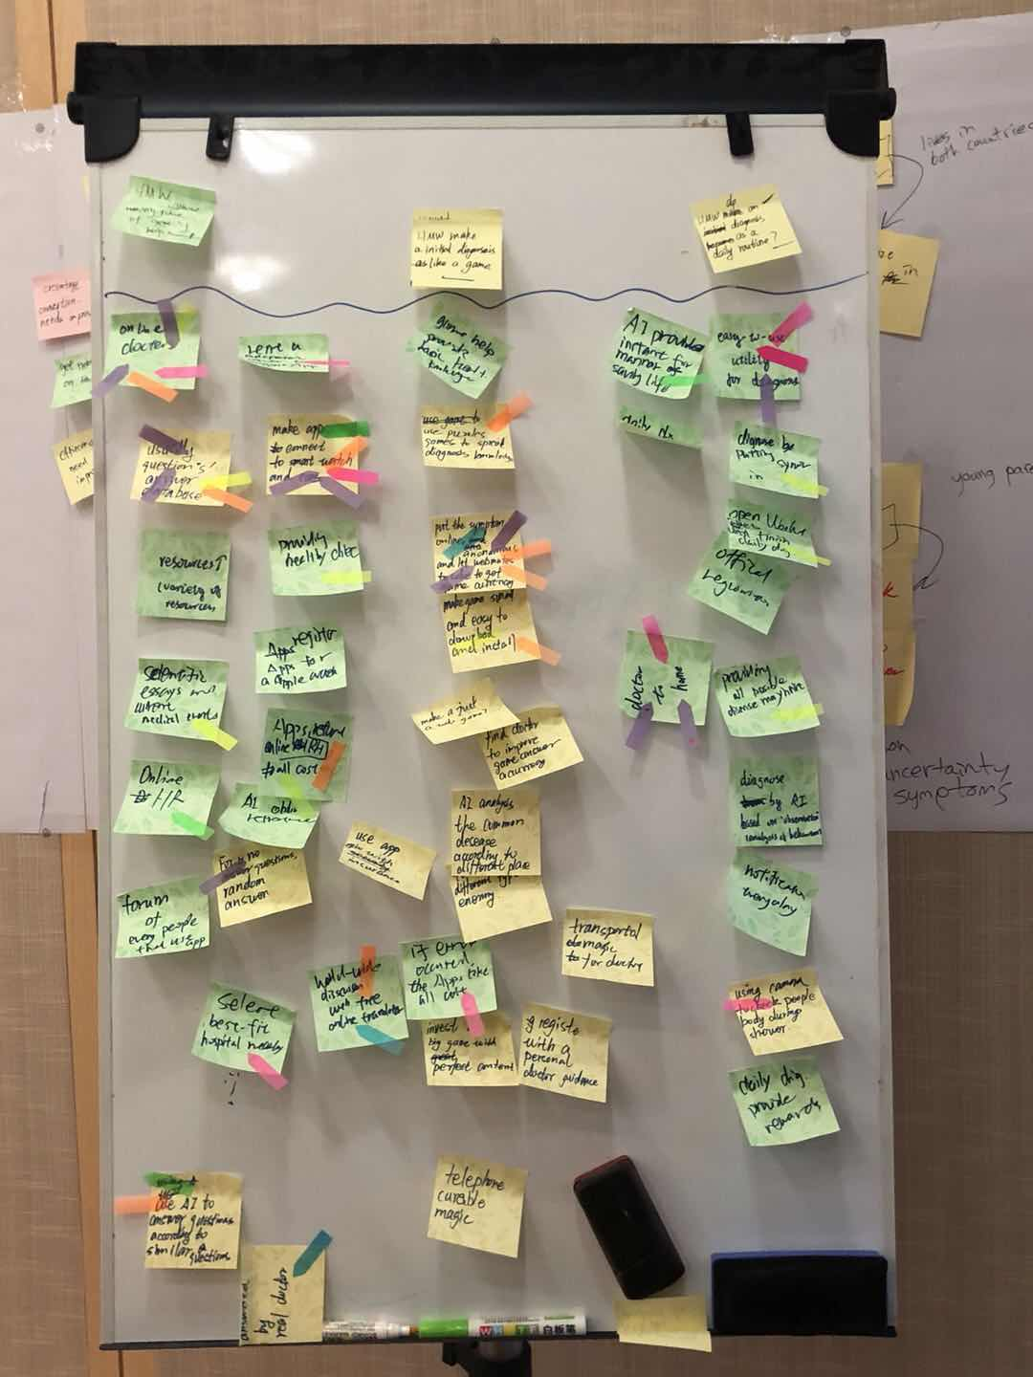
How Might We?
Solutions
HMW Questions
Brainstorming Ideas
&
Voting
Three chosen ideas
Summer 2018
Designing & Prototyping Smart Applications – James Landay CS Summer Camp – viaX

Slide 11
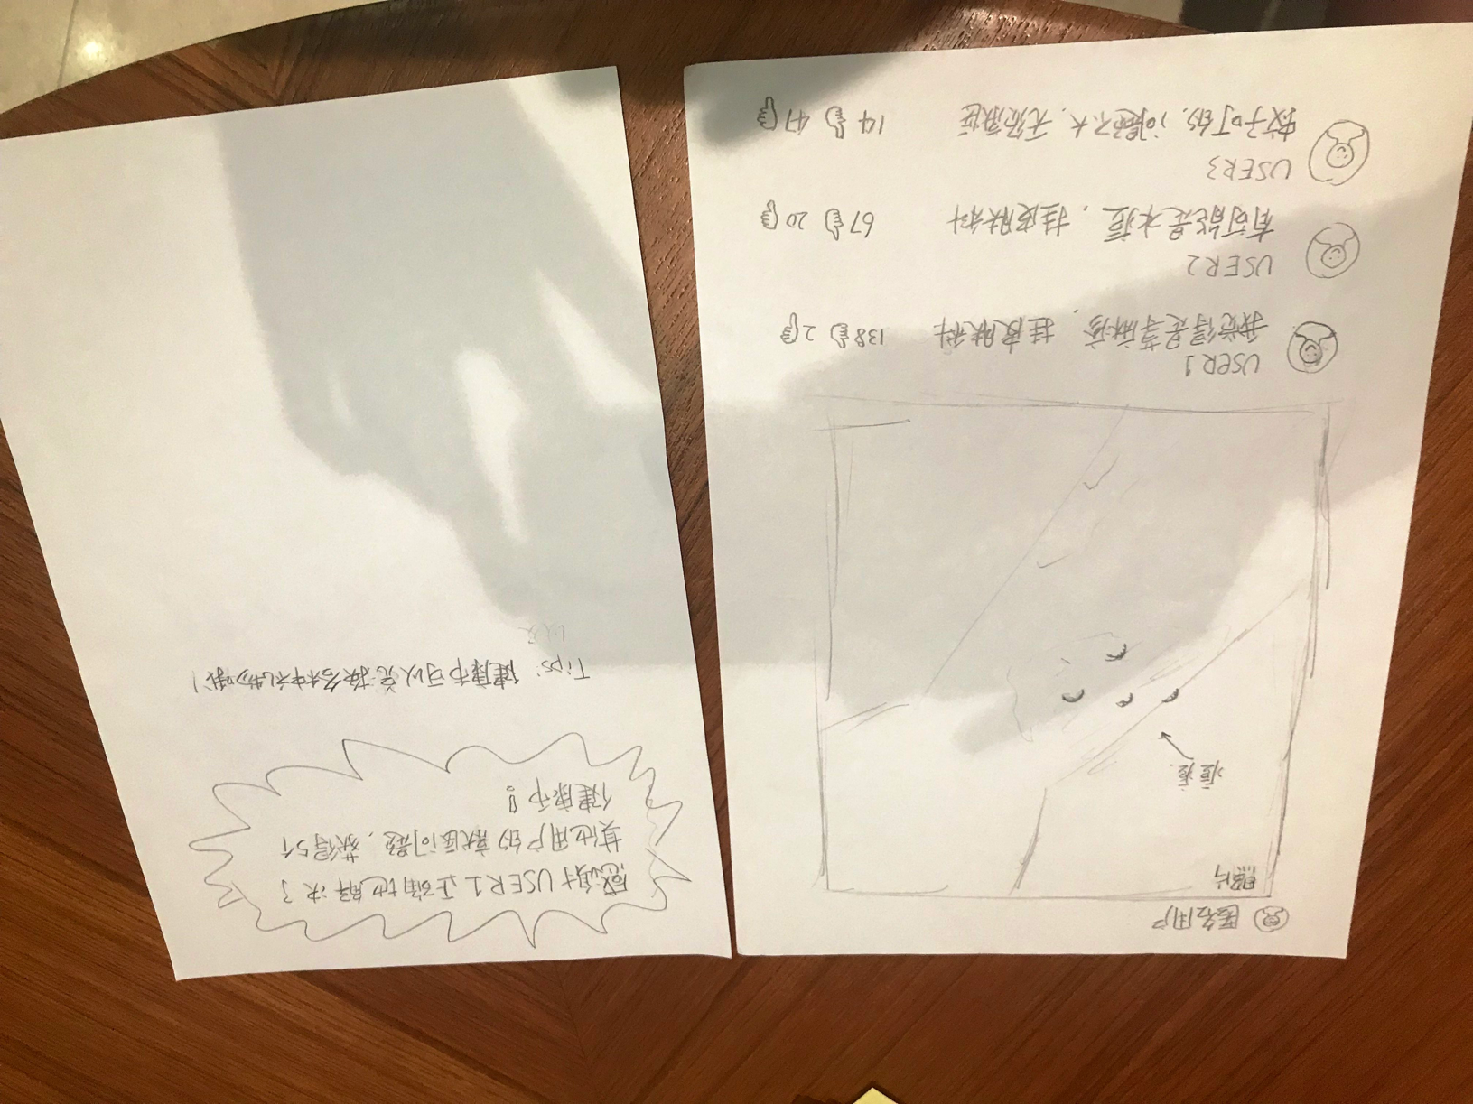
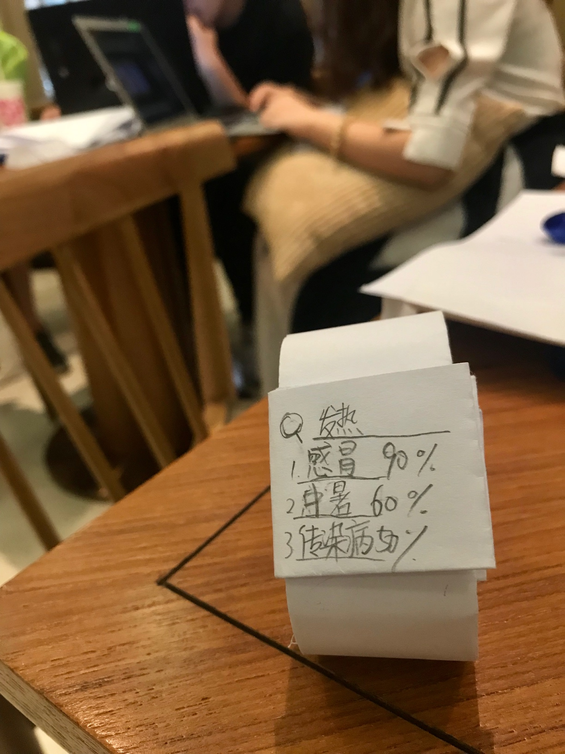
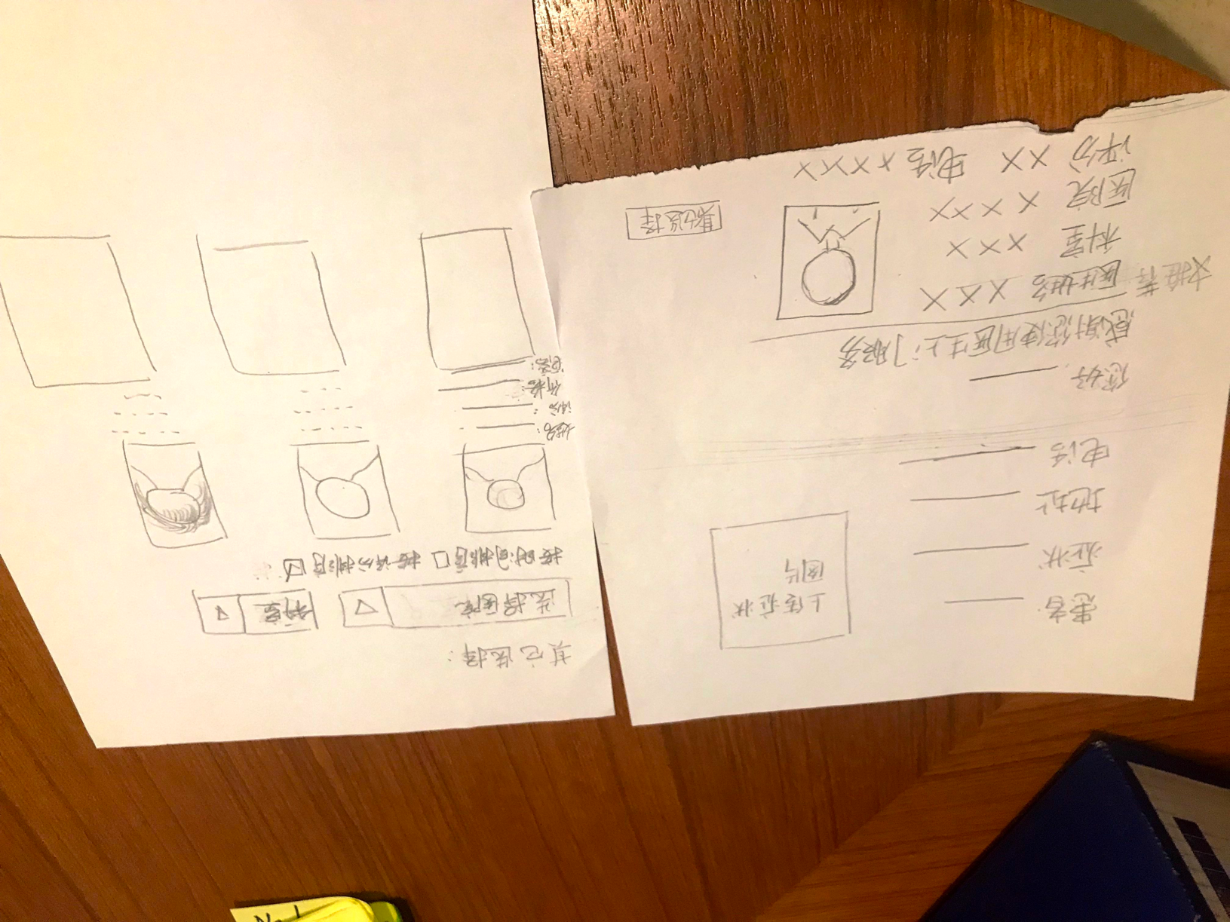
Experience Prototyping
Show Pictures of All 3
Highlight the One You Chose to Move Forward
Tell us briefly why you made that choice
Smart Health
Doctor to Home
pick the doctor and have him/her “delivered” to you
Online Forum
a platform for users answer others’ questions
connected to all of your devices and widgets
Summer 2018
Designing & Prototyping Smart Applications – James Landay CS Summer Camp – viaX
+

Slide 12
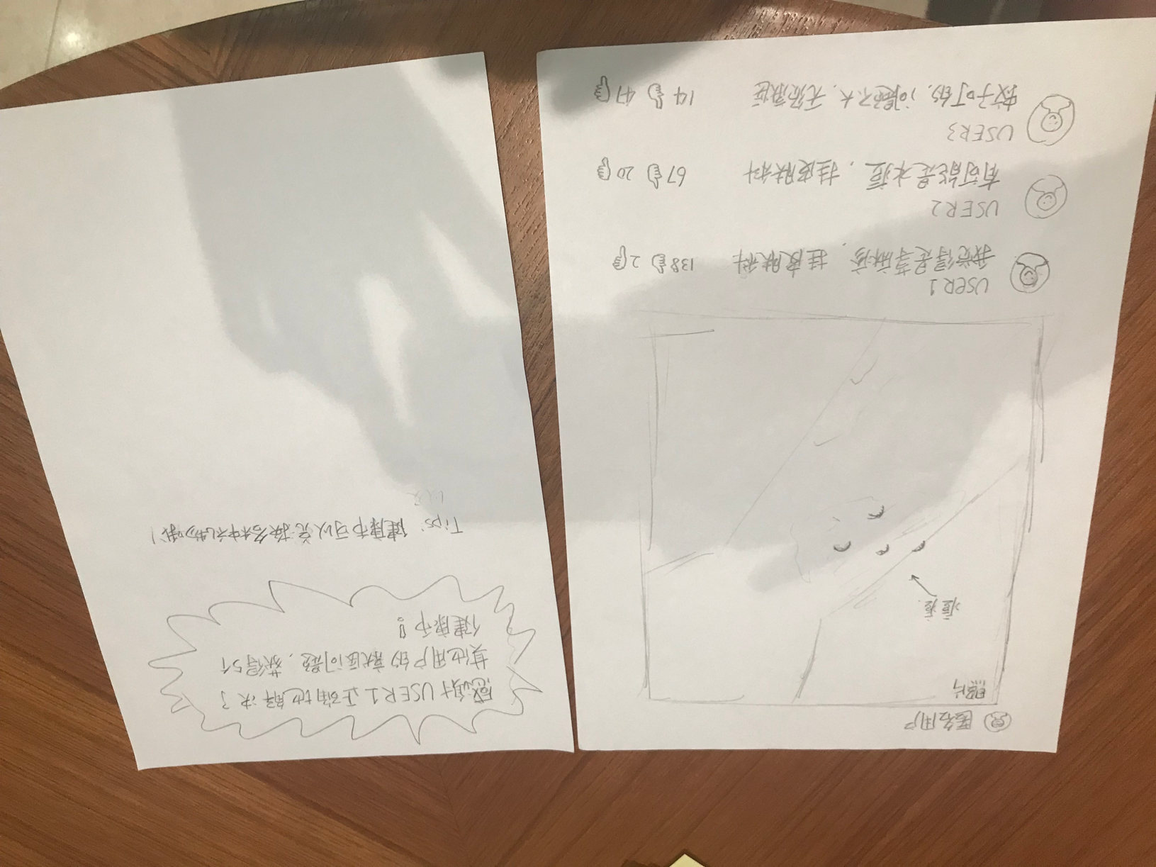
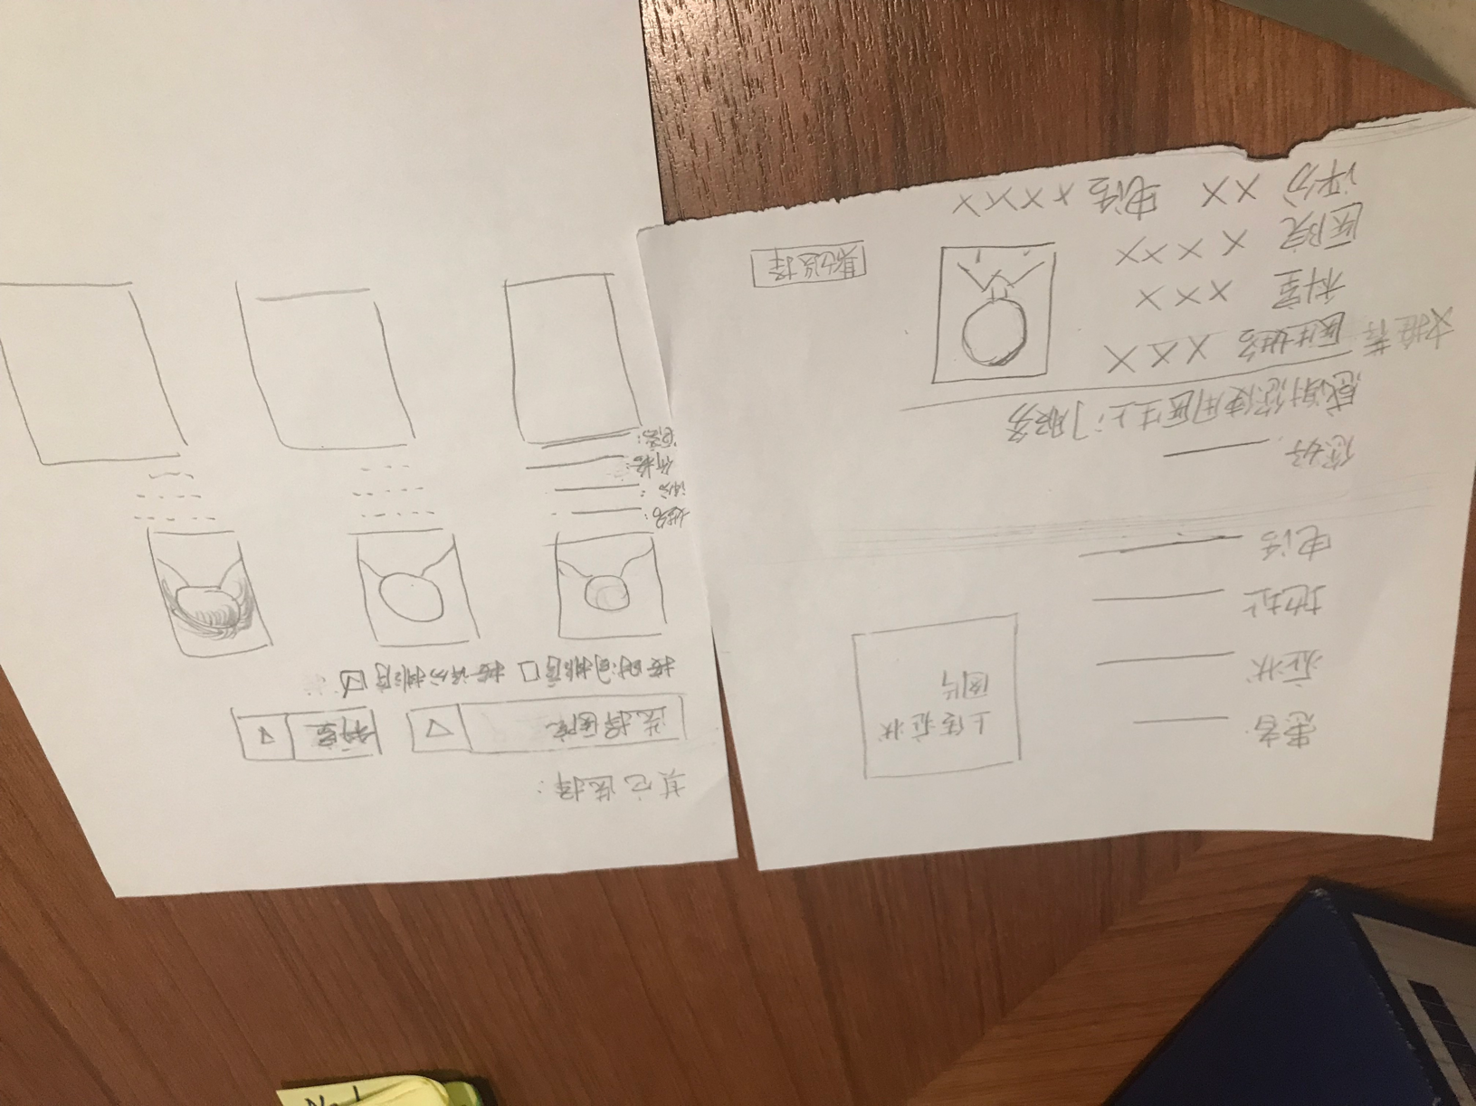
Experience Prototyping
Online Forum
Doctor to Home
a platform for users answer others’ questions
pick the doctor and have him/her “delivered” to you
+

Slide 13
Low-Fi Prototype & Testing
Jul.18th
Wed.
e
Summer 2018
Designing & Prototyping Smart Applications – James Landay CS Summer Camp – viaX
S
E
k
c
s

Slide 14
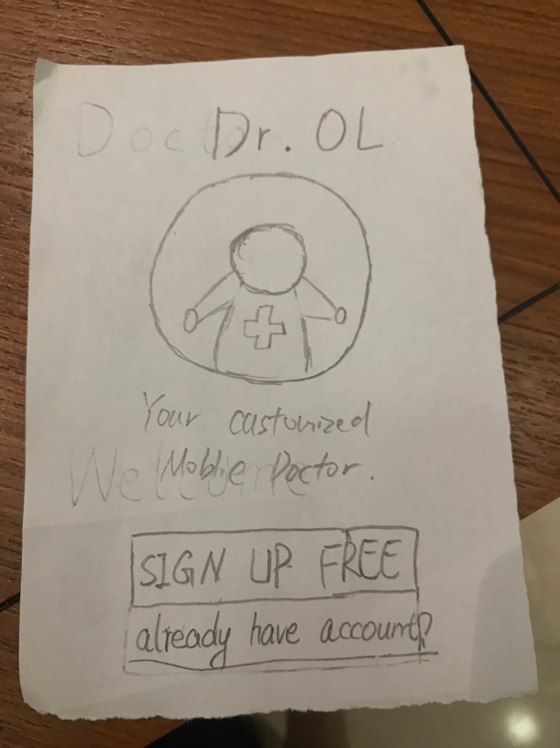
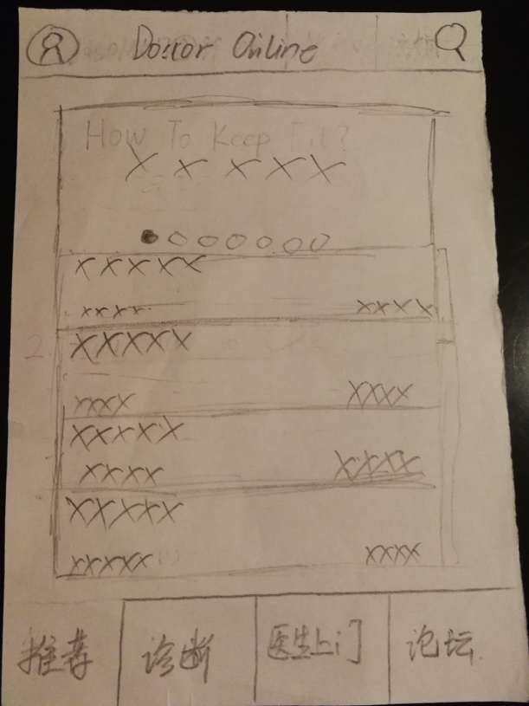
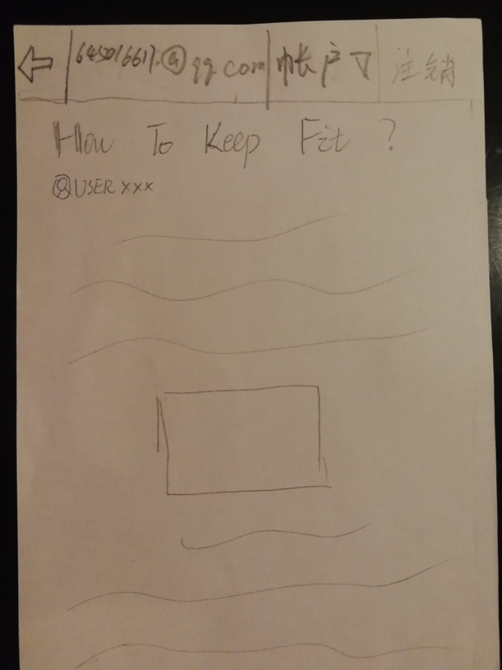
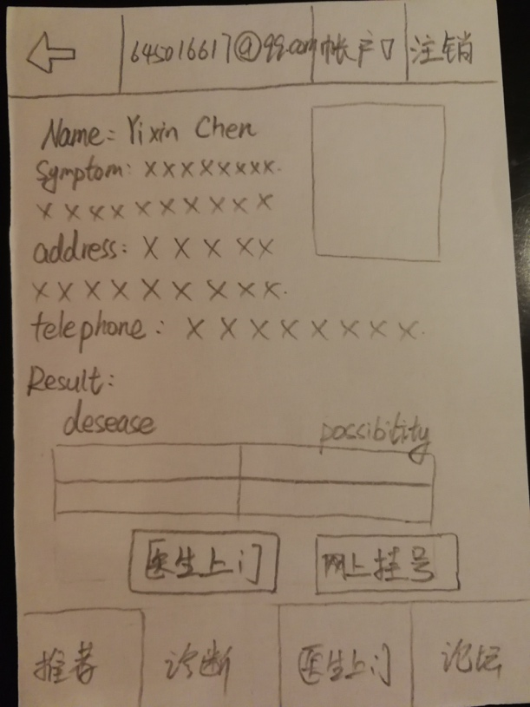
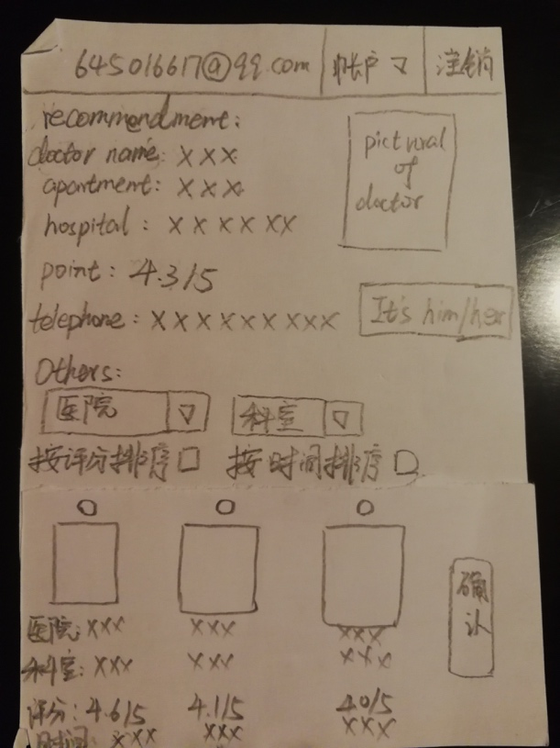
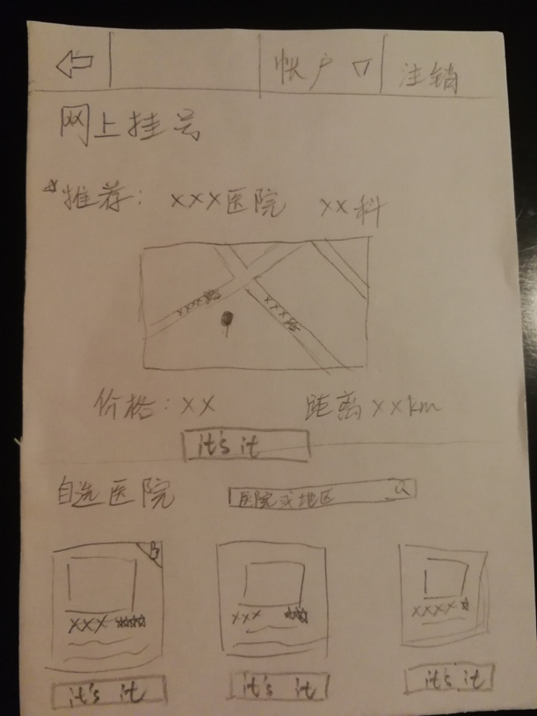
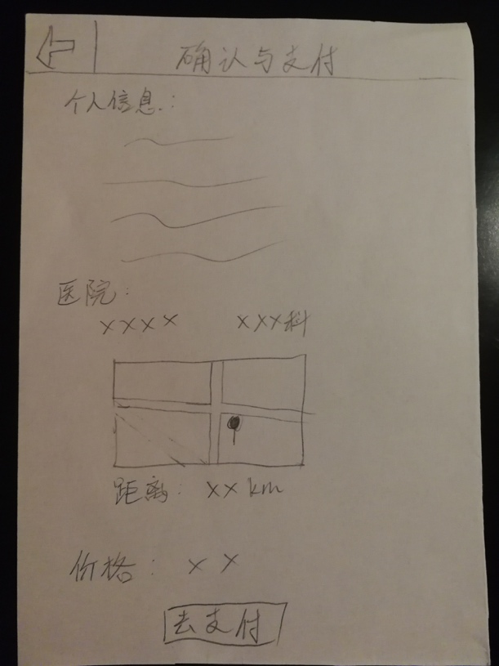
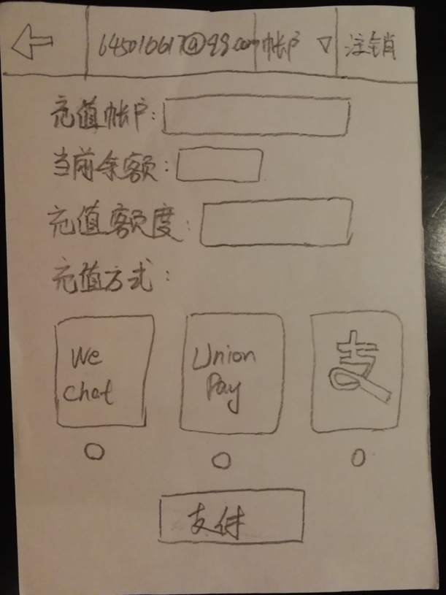
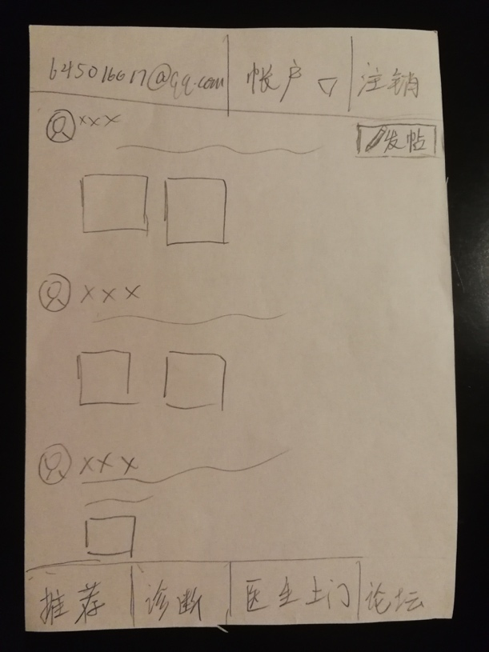
Low-Fi Prototype & Testing:
Sketches
s
s
Summer 2018
Designing & Prototyping Smart Applications – James Landay CS Summer Camp – viaX
T
k
a

Slide 15
Tasks
Low-Fi Prototype & Testing:
Low-Fi Prototype & Testing:
1. Schedule house call. You have a fever and are worried it might be something worse and you can’t leave your house. Find a doctor who can come visit your home to diagnose and provide treatment.
2. Smart diagnosis. You have a rash on your arm and don’t know what it is. Get an initial diagnosis based on your symptoms.
3. Group feedback. You’ve done what the doctor suggested about your rash, but are still have a bad itch for several days. Post photos of your symptoms online so other people can help suggest remedies.
Summer 2018
Designing & Prototyping Smart Applications – James Landay CS Summer Camp – viaX
y
K
e

Slide 16
Low-Fi Prototype & Testing: Key Results
List top 3-5 things you learned from your tests
If you have pictures (can get from wechat group) of the tests, please include some (this results can be multiple pages)
Low-Fi Prototype & Testing:
Certain pages are missing from the app
The design of the top nav bar can be revised to further improve convenience
Pop-up windows to be better designed to meet the expectation of users
Summer 2018
Designing & Prototyping Smart Applications – James Landay CS Summer Camp – viaX

Slide 17
Medium-Fi Prototype
Jul. 18th ~ Jul. 19th
Wed. & Thu.
Summer 2018
Designing & Prototyping Smart Applications – James Landay CS Summer Camp – viaX
#$

Slide 18
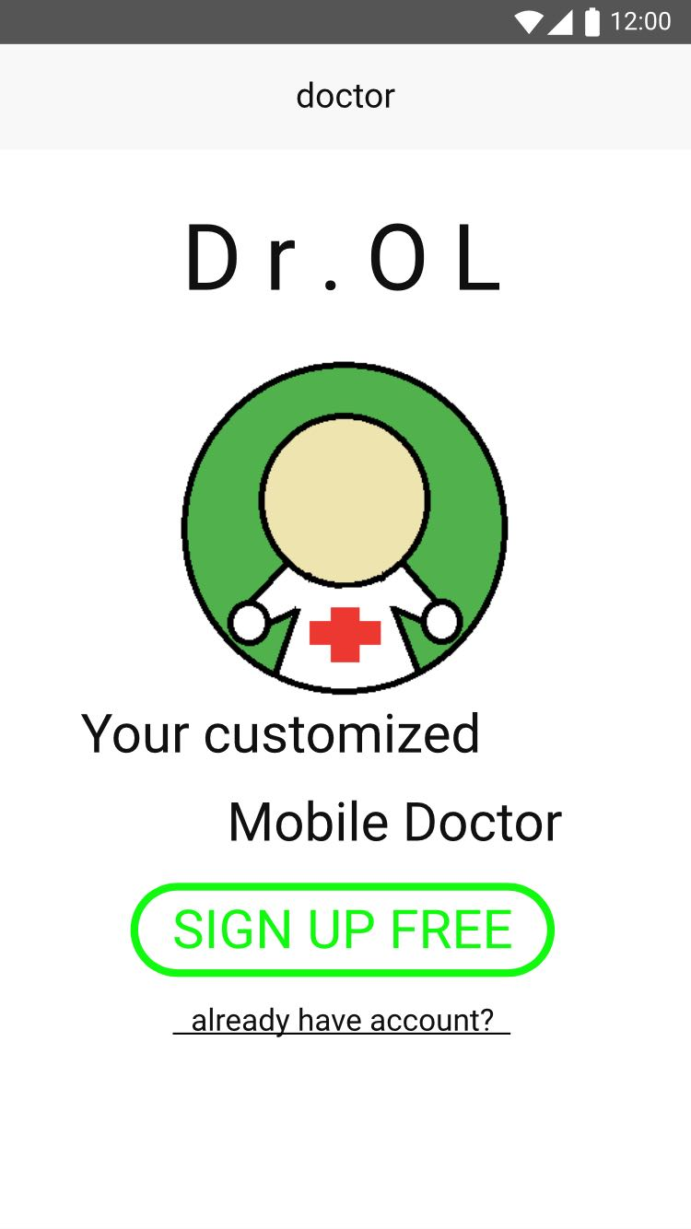
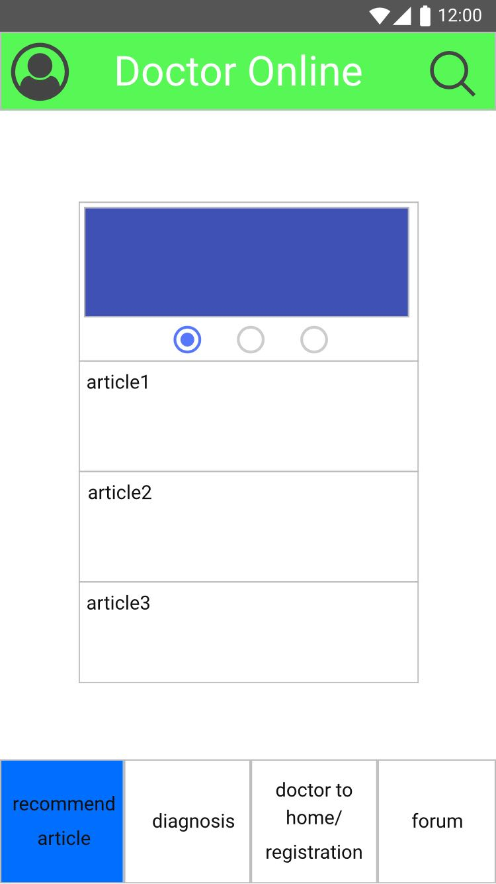
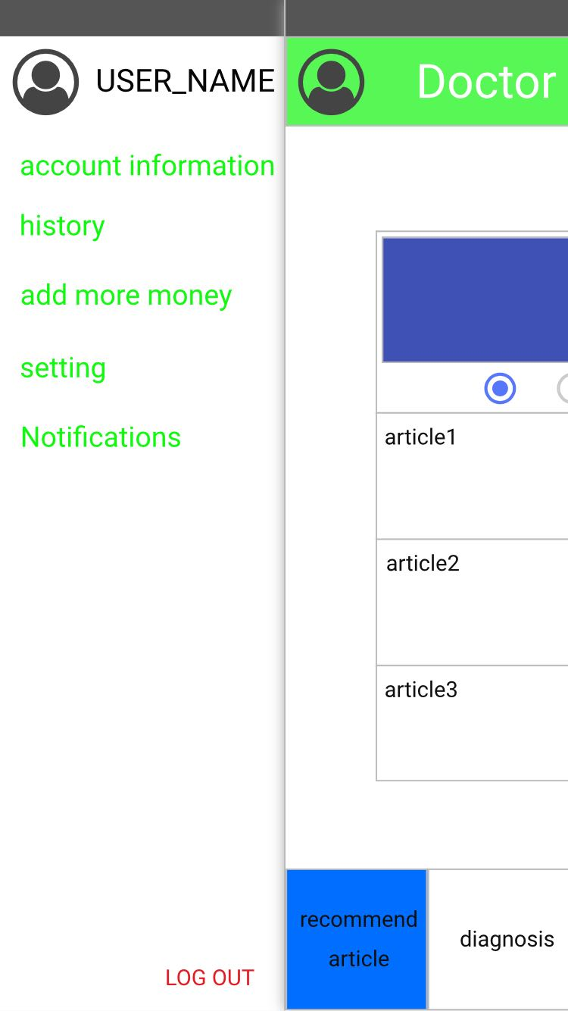
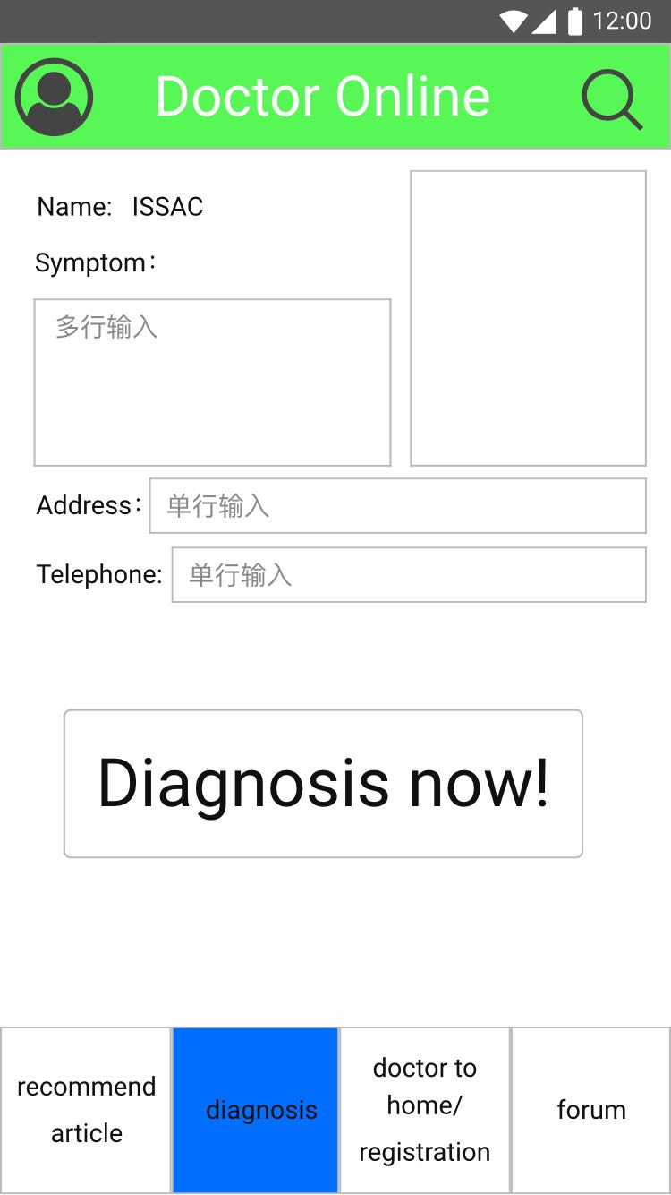
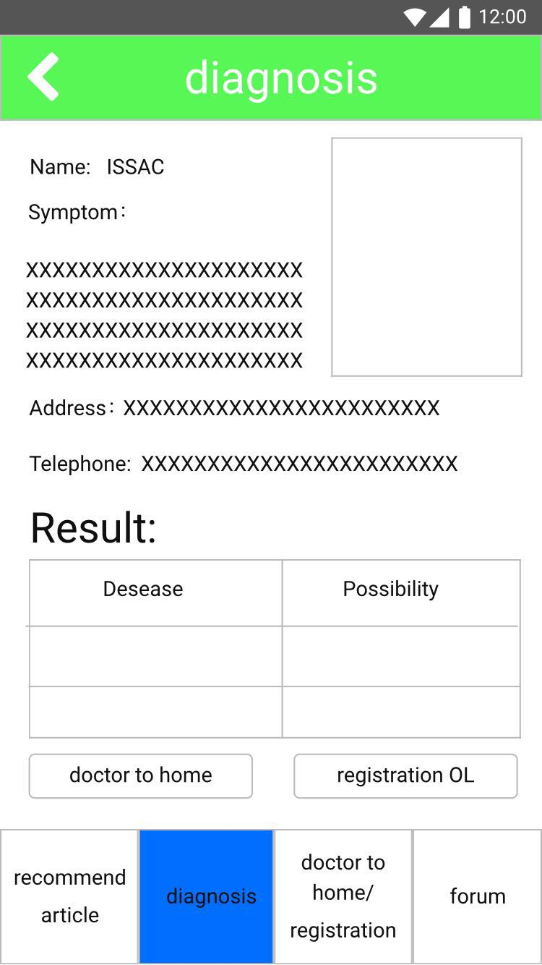
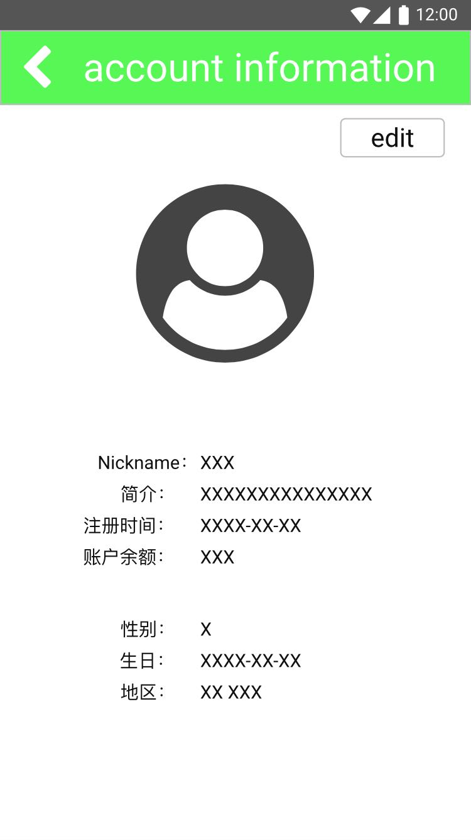
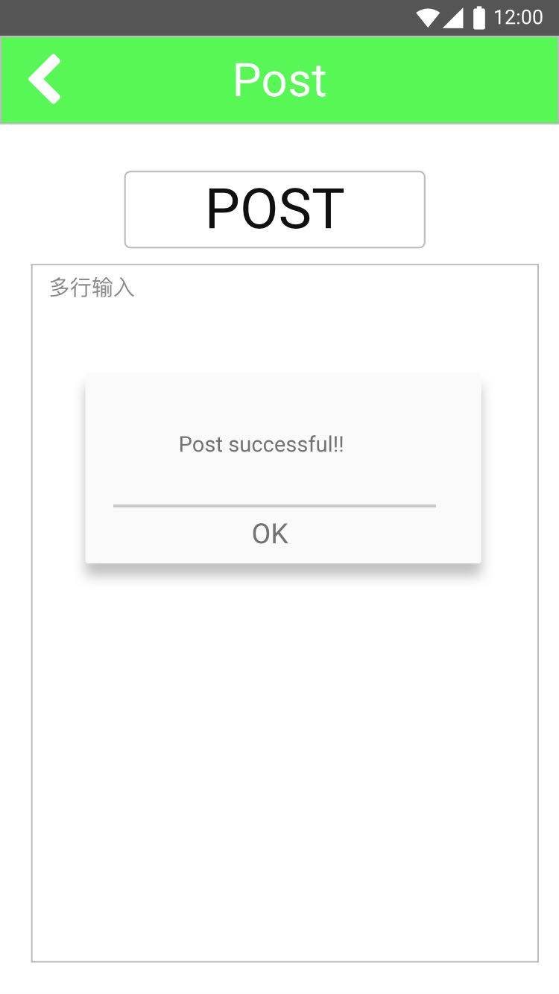
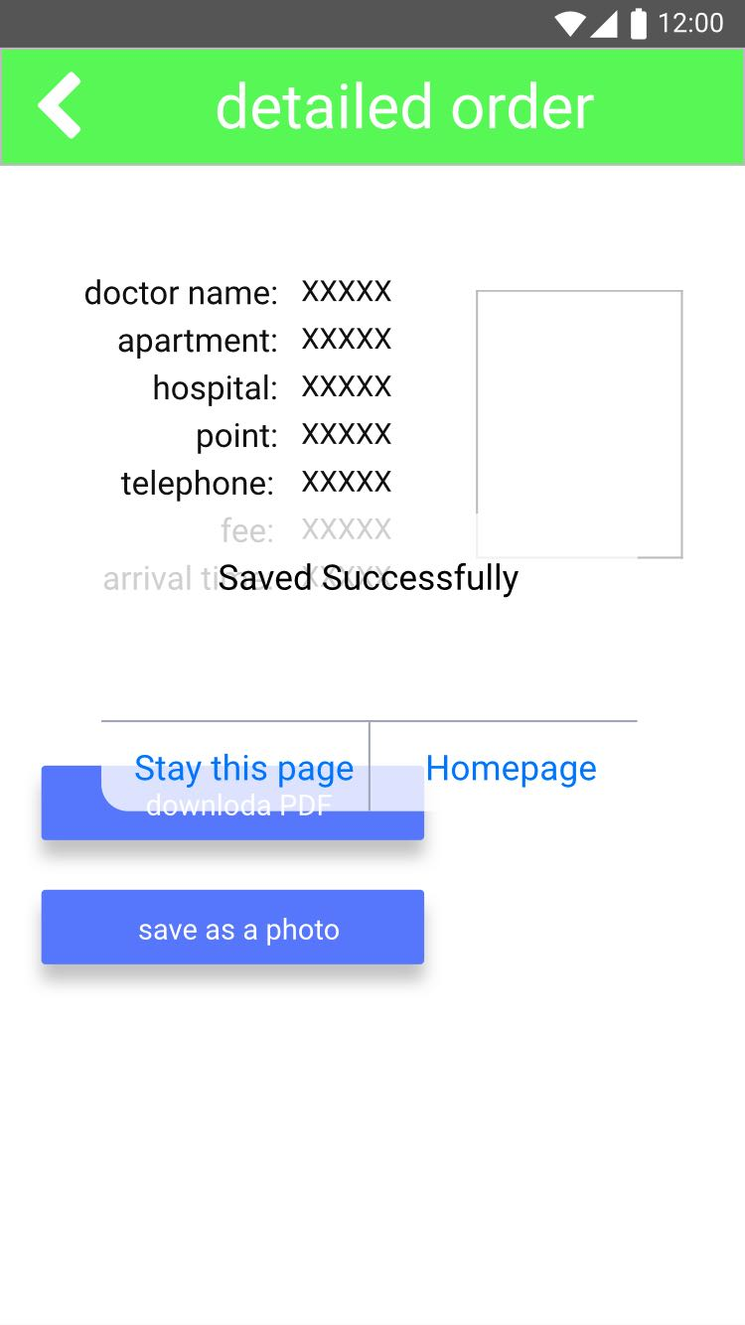
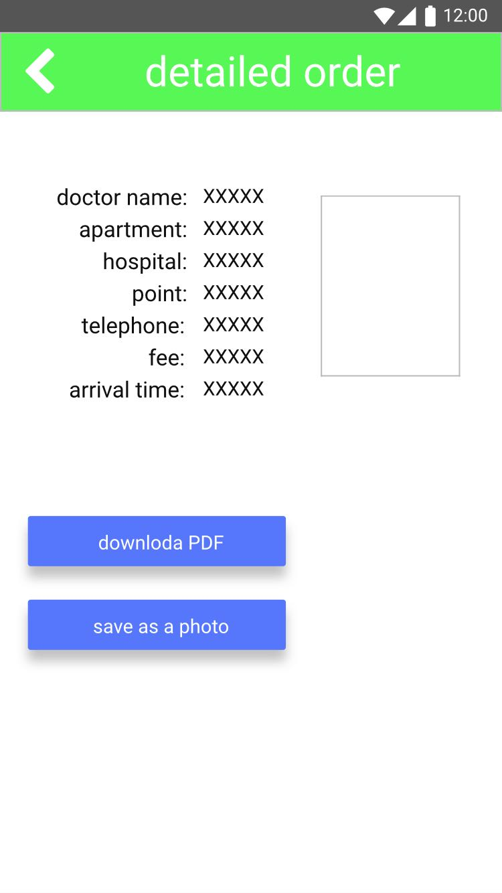
Medium-Fi Prototype #1
Summer 2018
Designing & Prototyping Smart Applications – James Landay CS Summer Camp – viaX

Slide 19
Group Heuristic Evaluation
Jul.18th
Thu.
Summer 2018
Designing & Prototyping Smart Applications – James Landay CS Summer Camp – viaX

Slide 20
Group Heuristic Evaluation: Key Results
Lack of contrast between pop-up windows and original page
The “forget password” page is a dead end (no way back)
There are both Chinese and English in some pages
No way of canceling after checking the “Terms of Use” box
Buttons not working
Summer 2018
Designing & Prototyping Smart Applications – James Landay CS Summer Camp – viaX

Slide 21
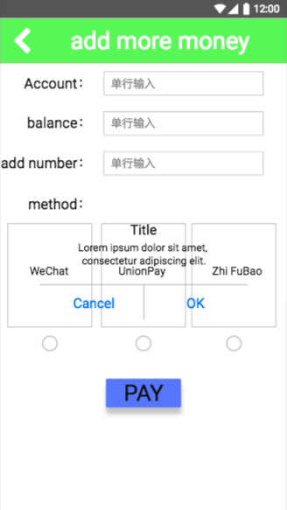
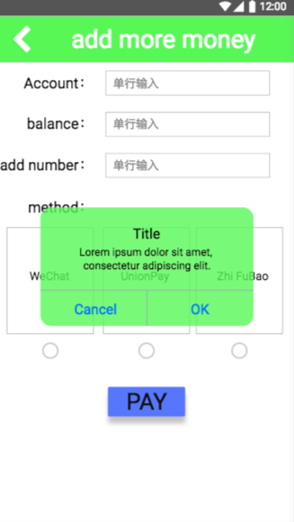
Medium-Fi Prototype #2: Key Changes
Background color changed from blank white to green in order for a stronger contrast as well as to cover the page underneath
Summer 2018
Designing & Prototyping Smart Applications – James Landay CS Summer Camp – viaX

Slide 22
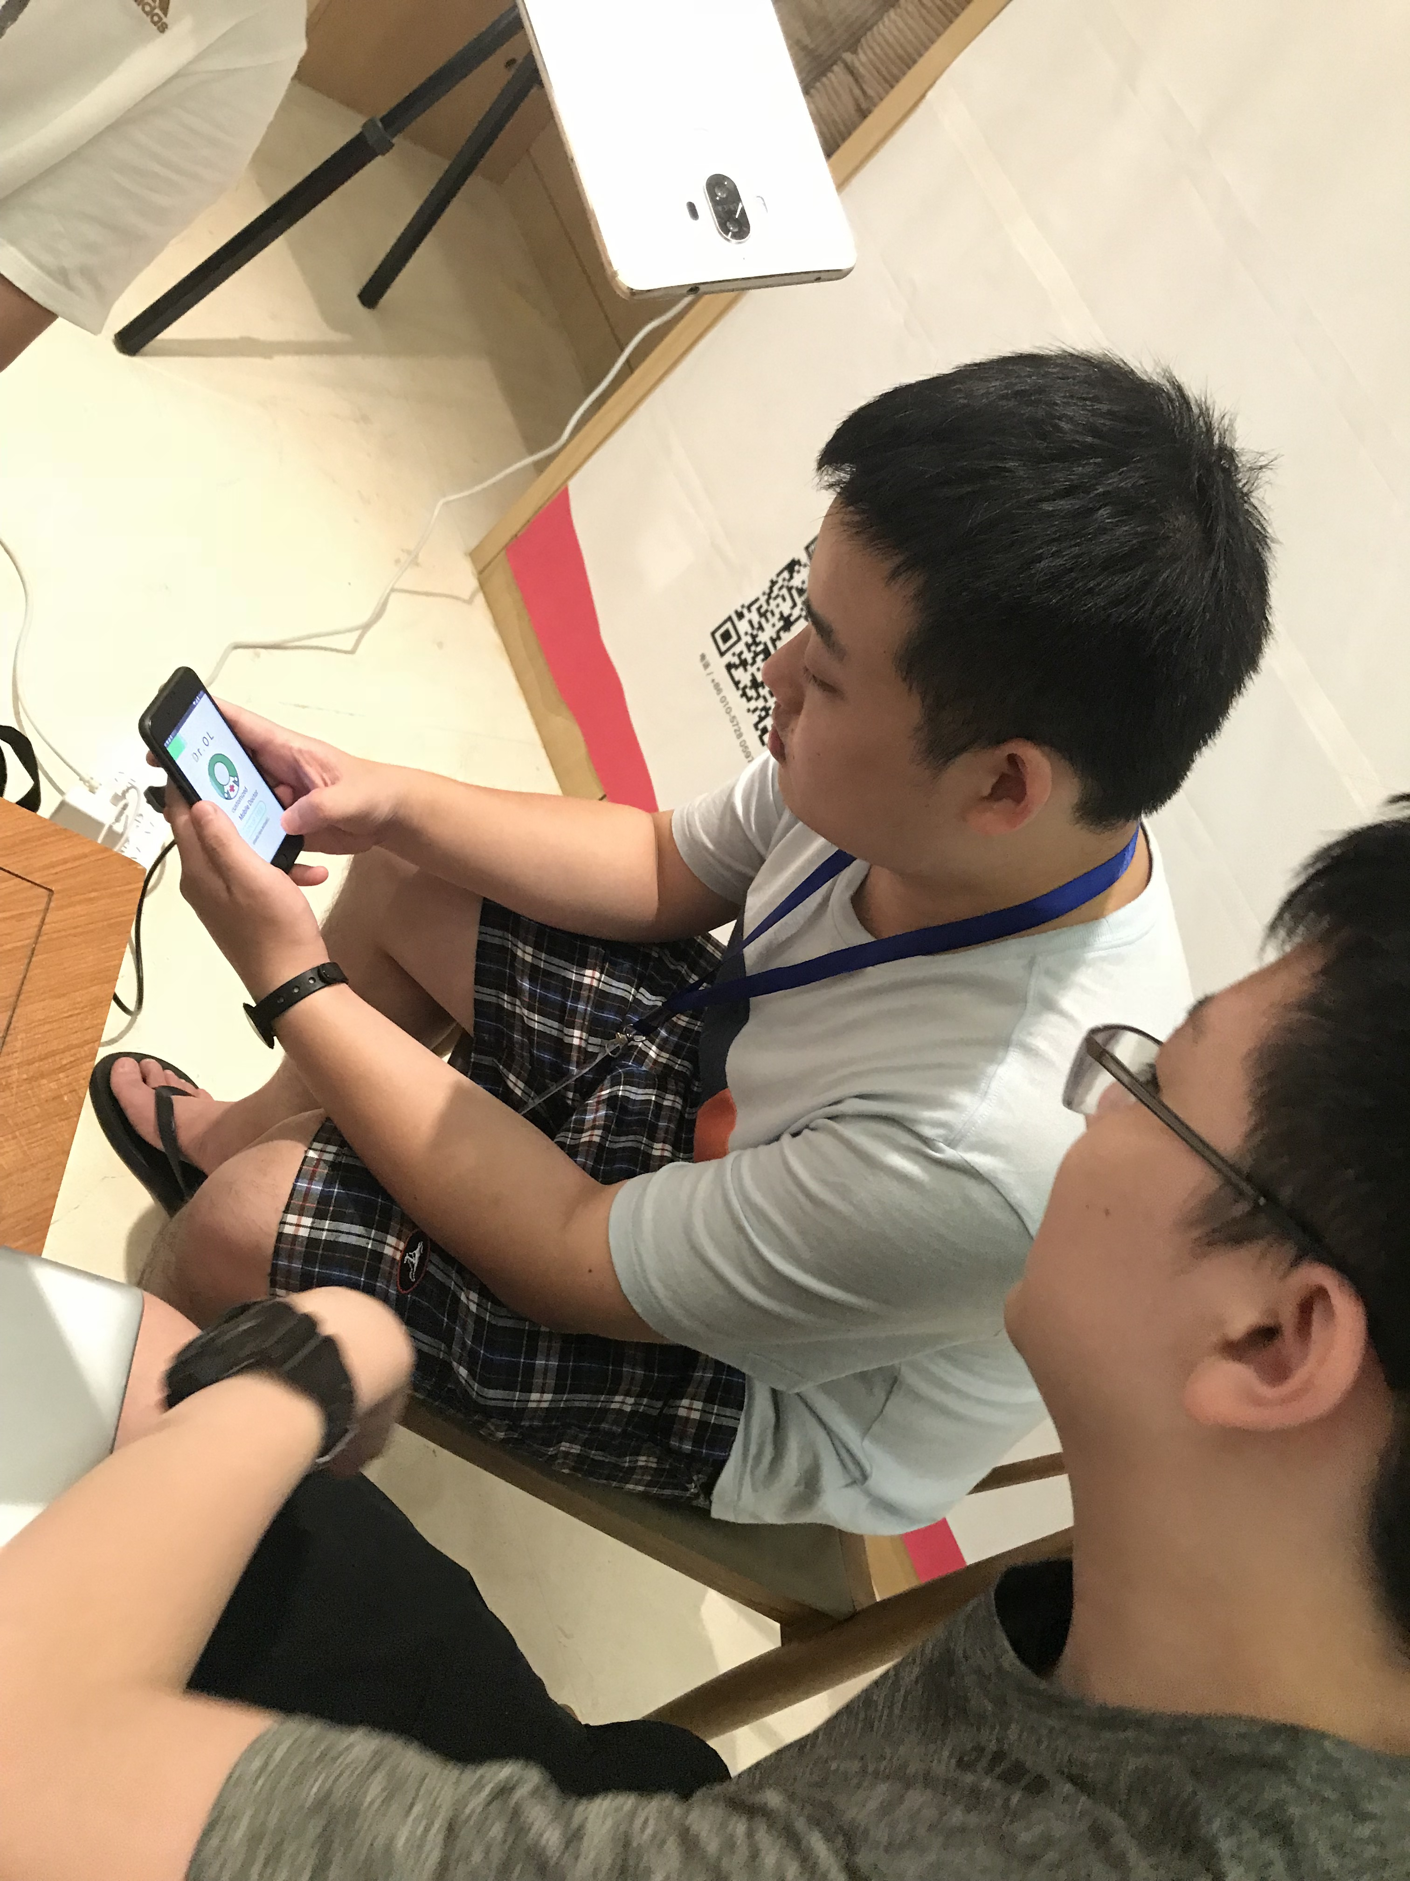
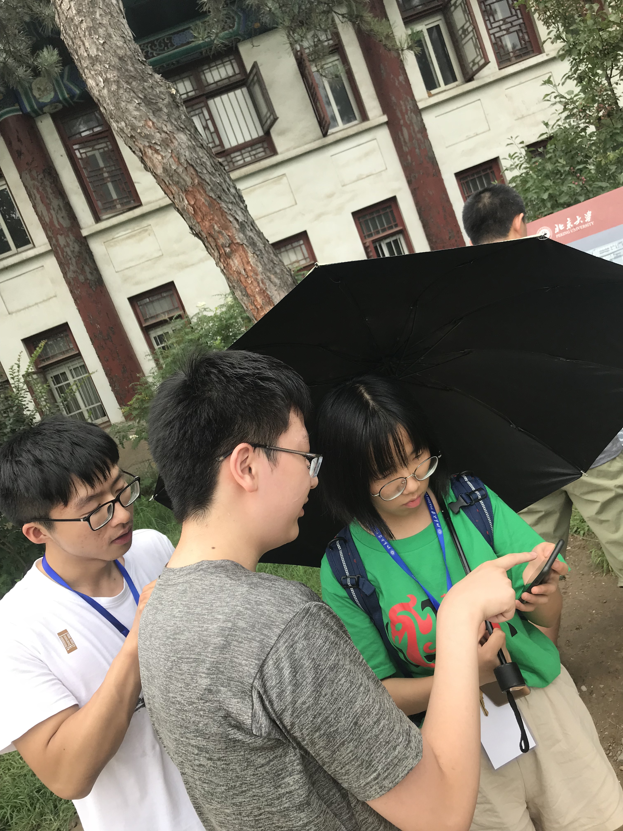
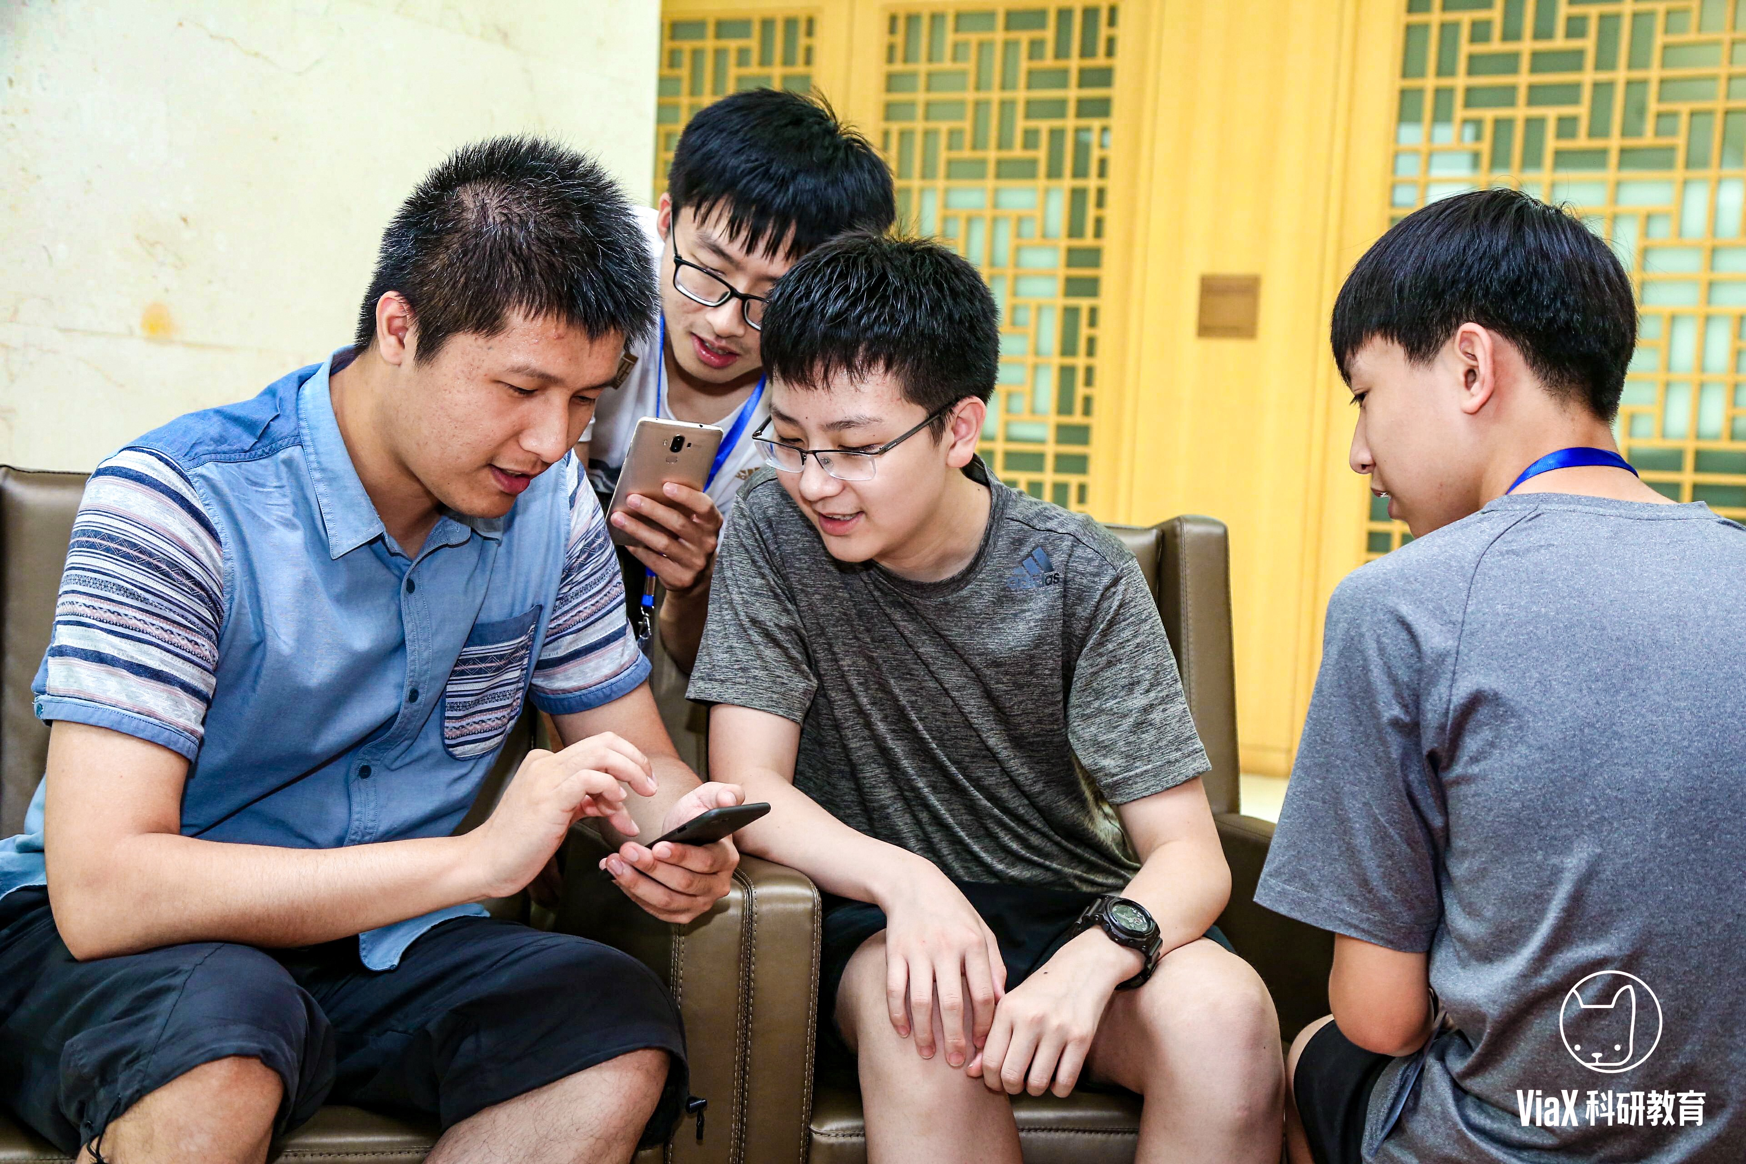
Usability Test: Medium-Fi Prototype #2
“Log in successful” window is not necessary
The direction of the “Back” icon is confusing
Certain triggering areas of buttons not big enough
Inconvenient for users
Summer 2018
Designing & Prototyping Smart Applications – James Landay CS Summer Camp – viaX

Slide 23
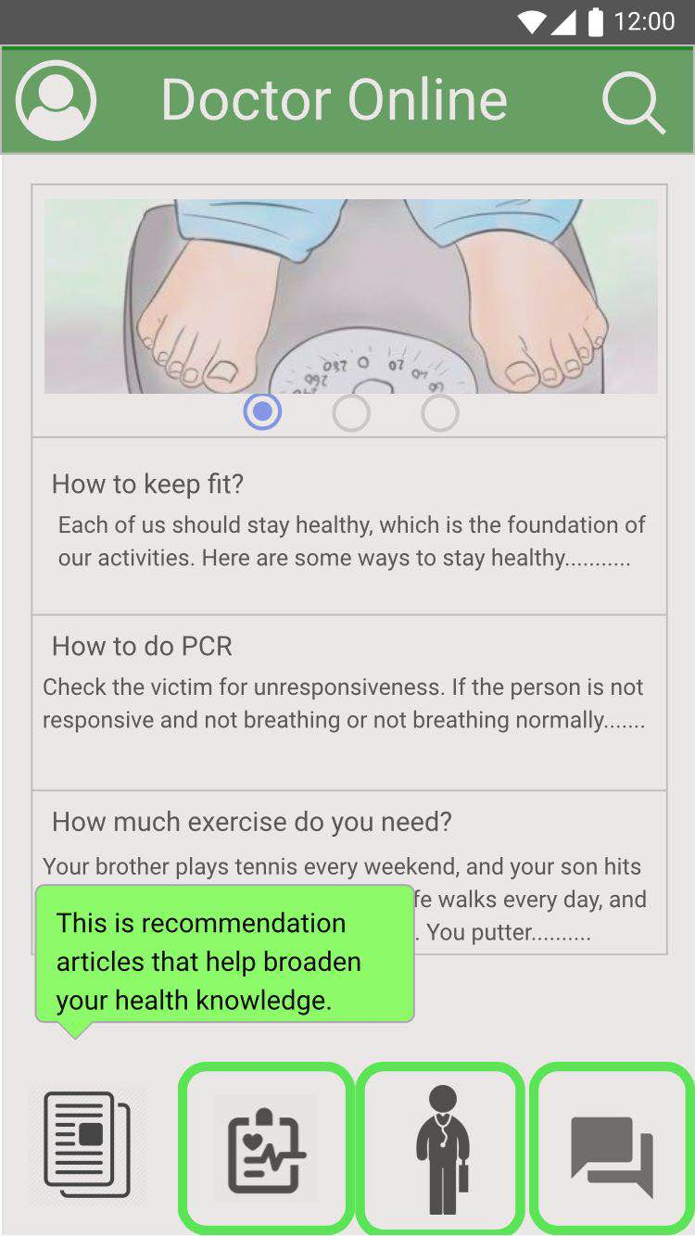
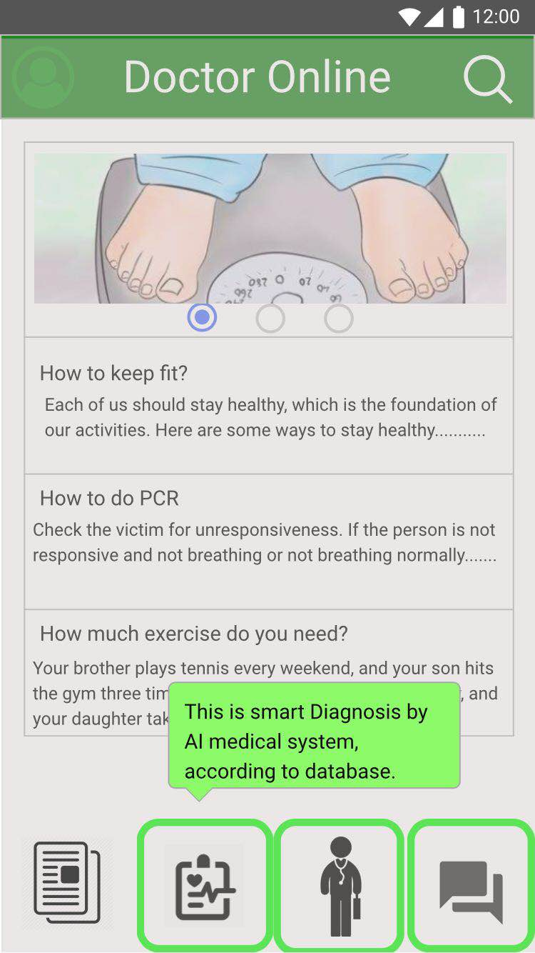
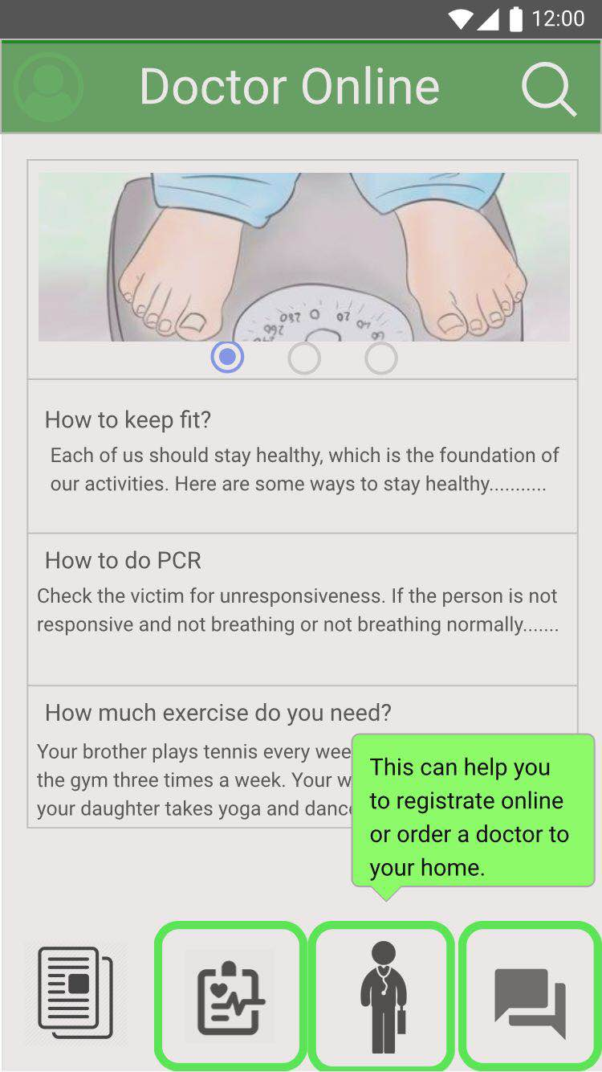
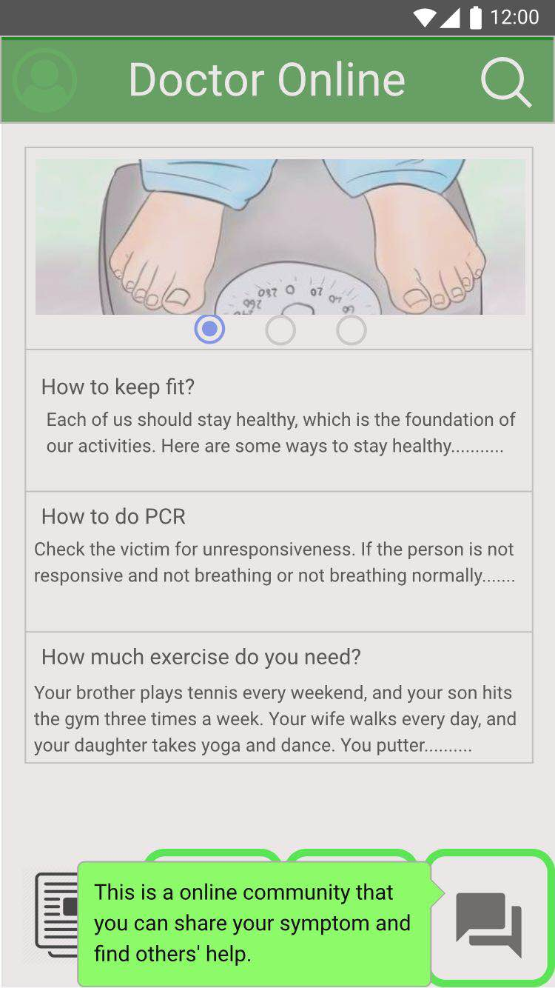
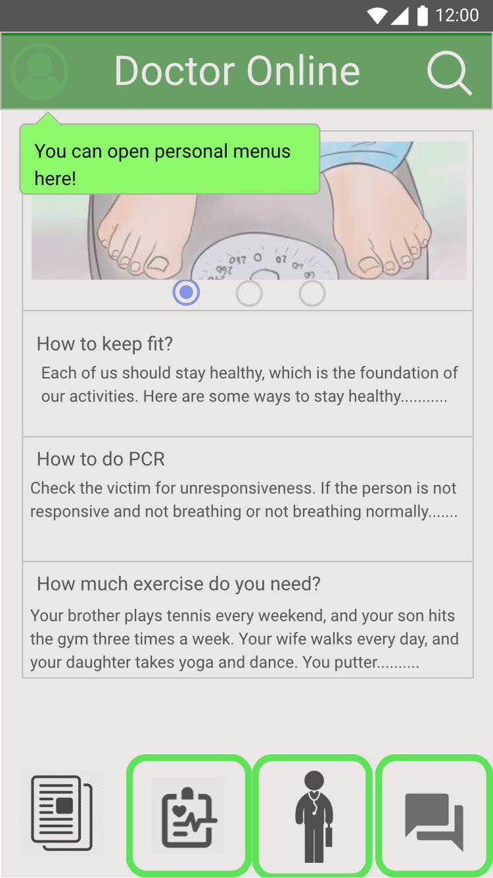
Medium-Fi Prototype #3: Key Changes
Tutorial at the first log in
Summer 2018
Designing & Prototyping Smart Applications – James Landay CS Summer Camp – viaX

Slide 24
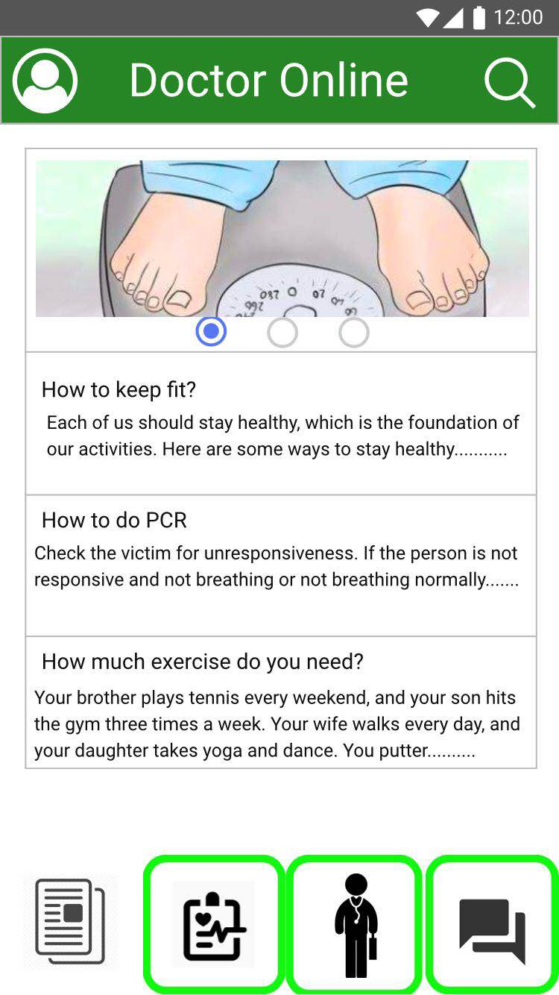
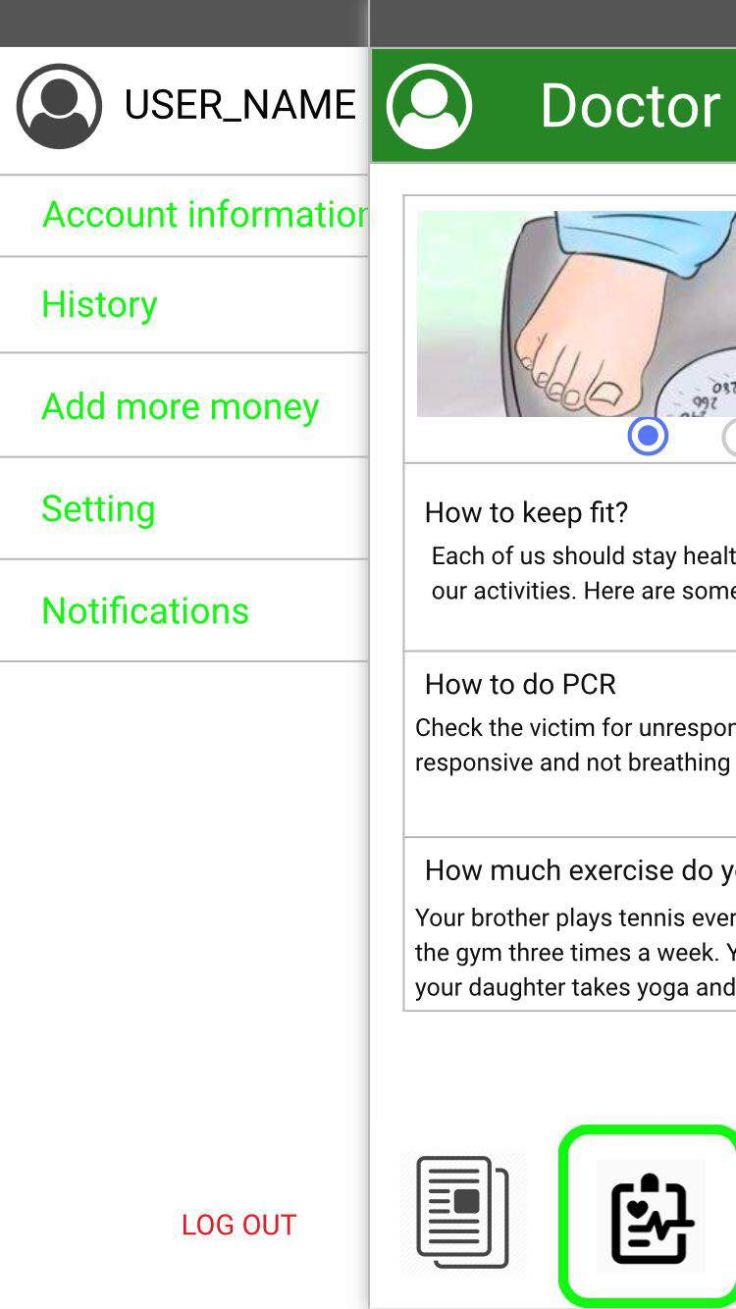
Medium-Fi Prototype #3
Change in the color
Summer 2018
Designing & Prototyping Smart Applications – James Landay CS Summer Camp – viaX

Slide 25
Conclusion
Week At A Glance
Summer 2018
Designing & Prototyping Smart Applications – James Landay CS Summer Camp – viaX

Slide 26
Conclusion
Doctor Online, Your Customized Mobile Doctor
Our Dr.Online derives from several ideas in our board of brainstorming. then we made it on the paper with lots of mistakes. when we put it into modao and marvels, it becomes an App, although there are lots of dead ends. And by numerous tests and experiments, Dr.Online finally turns to what it looks like right now.
Summer 2018
Designing & Prototyping Smart Applications – James Landay CS Summer Camp – viaX

Slide 27
Conclusion
Ke: This is not only a tough week ---- we get up early and stay up late---- but also a amazing week ----everyone takes a big step toward future success----that I never thought it would be. Thanks for professor Landay, our TAs, our teachers from ViaX, and my cute classmates.
Issac: After this week, I have learned how to make a prototype. Some tools like Stretch and Marvel are quite useful and easy to learn. More importantly, we have learned Stanford popular design process from empathizing to Test, five steps. I really appreciate professor since this is such a wonderful week time. Also, during this time, I obtained friendships with different ages guys including two really clever and cute teammates who leave me a pretty good memory.
Bill: This week was undoubtedly an exhausting and yet rewarding experience. Not only from classroom lectures, we learned lots and lots from actually experiencing and implementing the things we have learned in class. From all these tiring days, working day and night, we challenged ourselves and sought for a higher level. Despite all the challenges we had to overcome, we had so much fun learned so much from the teachers and from each other.

Slide 28
Conclusion
Project name: doctor.onlin URL:https://modao.cc/app/7e5f862a0206cc0ce00fa0cb53671ce7139a26ff

